Slide 1
Null model correction with fdrtool
Aneuploidy project
Holly McQueary
Summer 2018

Slide 2
What the problem was
DESeq2 calculates a single variance for each gene across all samples
Samples that don’t have similar variances to the calculated variance will be thrown off
My data’s variance is all over the place, so several looked crazy.
To fix this, can use p-value correction
Two ways:
Fdrtool (the one I’ve used so far) http://strimmerlab.org/software/fdrtool/
Another R-based method found in this paper: https://www.degruyter.com/view/j/sagmb.2014.13.issue-6/sagmb-2013-0074/sagmb-2013-0074.xml
I haven’t tried this one yet, not sure if I should or just stay with fdrtool

Slide 3
What I did
Performed DESeq differential expression analysis on samples
Once including aneuploid chromosomes in the normalization procedure
Once excluding aneuploid chromosomes in the normalization procedure
Because: another paper (cite) took out the aneuploid chromosomes in their normalization so that the program didn’t normalize to them and throw a lot of things off
Created p-value histograms for each sample of:
Aneuploid chromosomes included, no correction
Aneuploid chromosomes included, correction
No aneuploid chromosomes included, no correction
No aneuploid chromosomes included, no correction

Slide 4
This slideshow...
In the following slides, I show each of the above histograms for each sample. I have marked in a red box which histogram (i.e. analysis method) I will use for that sample. Slides marked with a lime green lightning bolt are ones I am unsure of. I have provided a brief explanation of my choice of analysis in the notes section of each slide.
The #DE is the number of differentially expressed genes with a padj<0.1
My questions are:
Is it okay to do a different analysis procedure on different samples (i.e. fdrtool variance correction on one and not the other) ?
Do my choices of analysis method make sense?
What should I do about samples 2,3, 5, 6, and 9? These are all euploids.

Slide 5
My assumptions
The p-value histogram under the null model should be uniform
Samples with aneuploid chromosomes should have higher numbers of DE genes
Samples without aneuploid chromosomes should have lower numbers of DE genes

Slide 6
Resources about fdrtool, null model variance correction, etc
DESeq2 and hill-shaped p-value histograms: https://support.bioconductor.org/p/102313/
DESeq2 and fdrtool: https://support.bioconductor.org/p/94020/
DEseq2 and fdrtool: https://support.bioconductor.org/p/93333/
Right-skewed p value histograms: https://support.bioconductor.org/p/35556/
DESeq2 and hill-shaped p-value histograms: https://support.bioconductor.org/p/71438/#71476
Blog post on how to interpret a p-value histogram: http://varianceexplained.org/statistics/interpreting-pvalue-histogram/
Link to fdrtool on CRAN: https://cran.r-project.org/web/packages/fdrtool/index.html

Slide 7
NOTE
Needs to be redone: we removed sample 6 from the analysis (GC)

Slide 8
Hybrid Samples

Slide 9
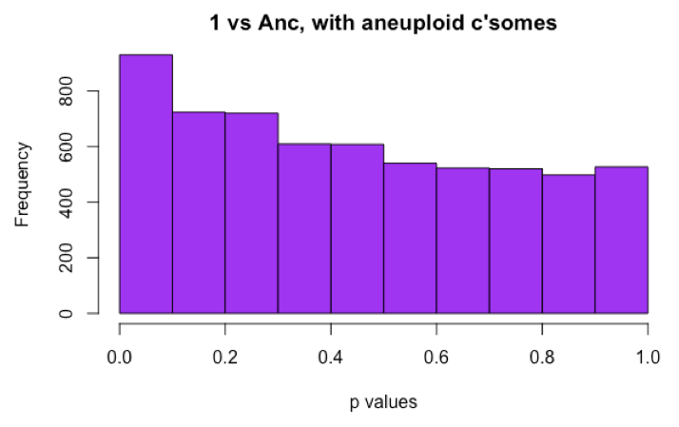
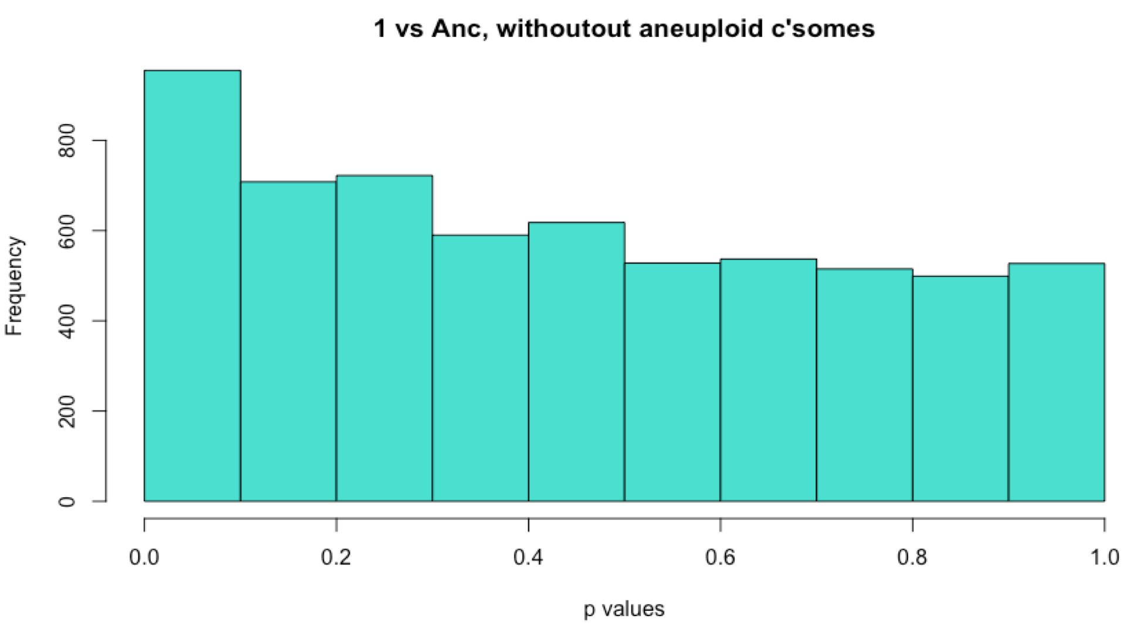
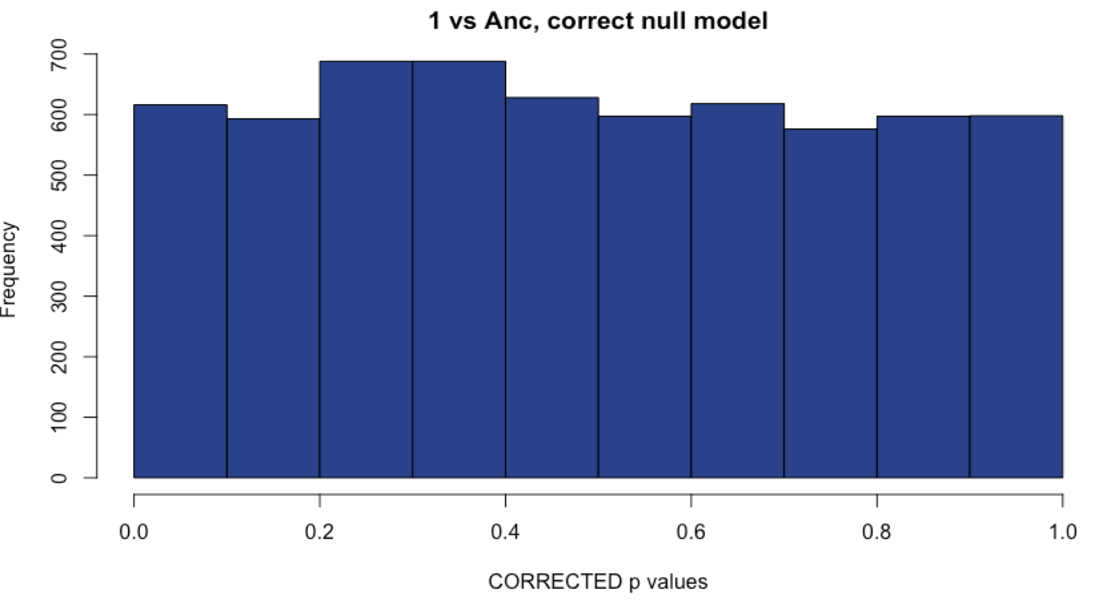
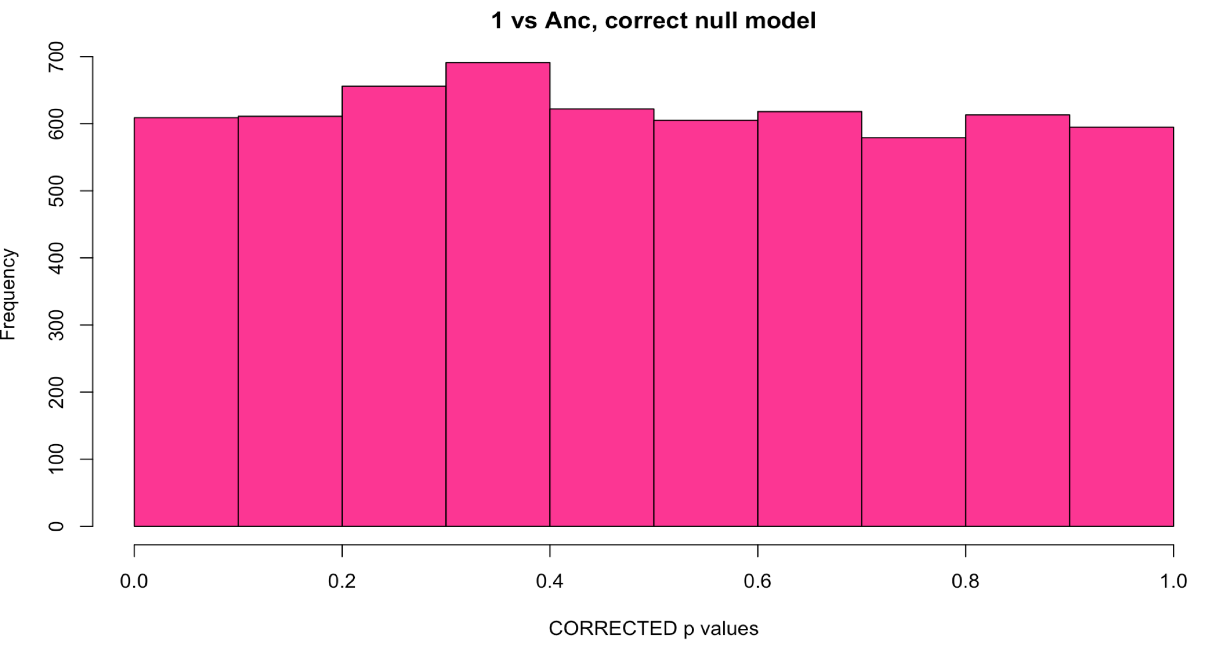
Sample 1: Comparison with methods
WITH Aneuploid C’somes WITHOUT Aneuploid c’somes
# DE: 23
# DE: 22
Uncorrected
Corrected with fdrtool
# DE: 0
# DE: 0
Notes:
For ALL OF THEM, I am choosing to exclude the aneuploid chromosomes from the normalization procedure because I believe they will be throwing off my data too much if I leave them in.
Sample 1, I chose uncorrected over corrected because I still obtained some differentially expressed genes, which is not the case for the corrected p values.

Slide 10
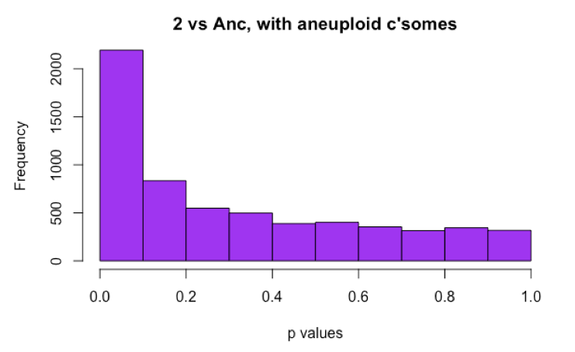
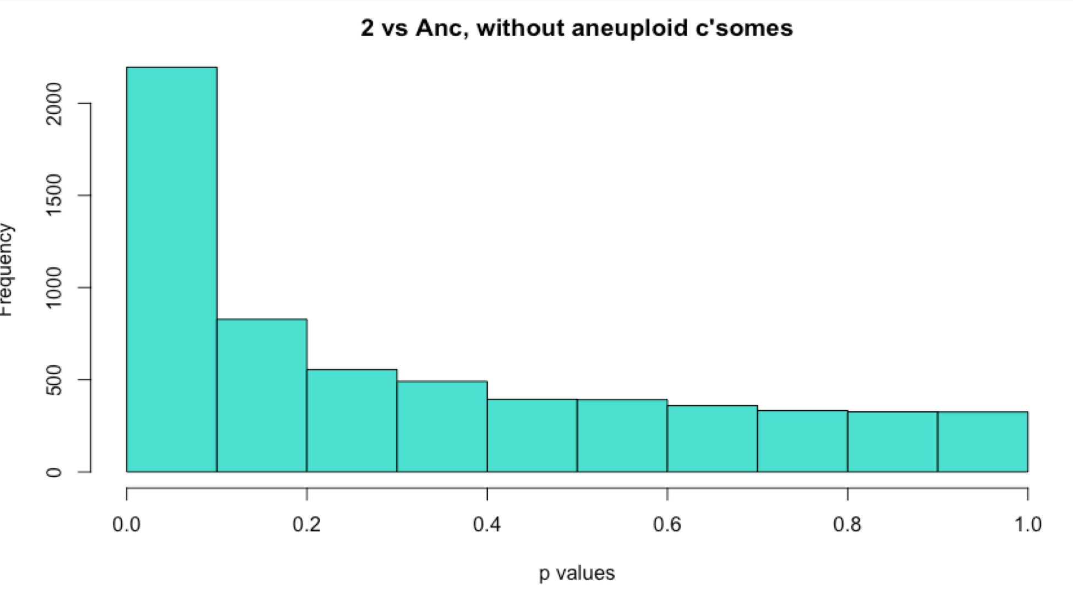
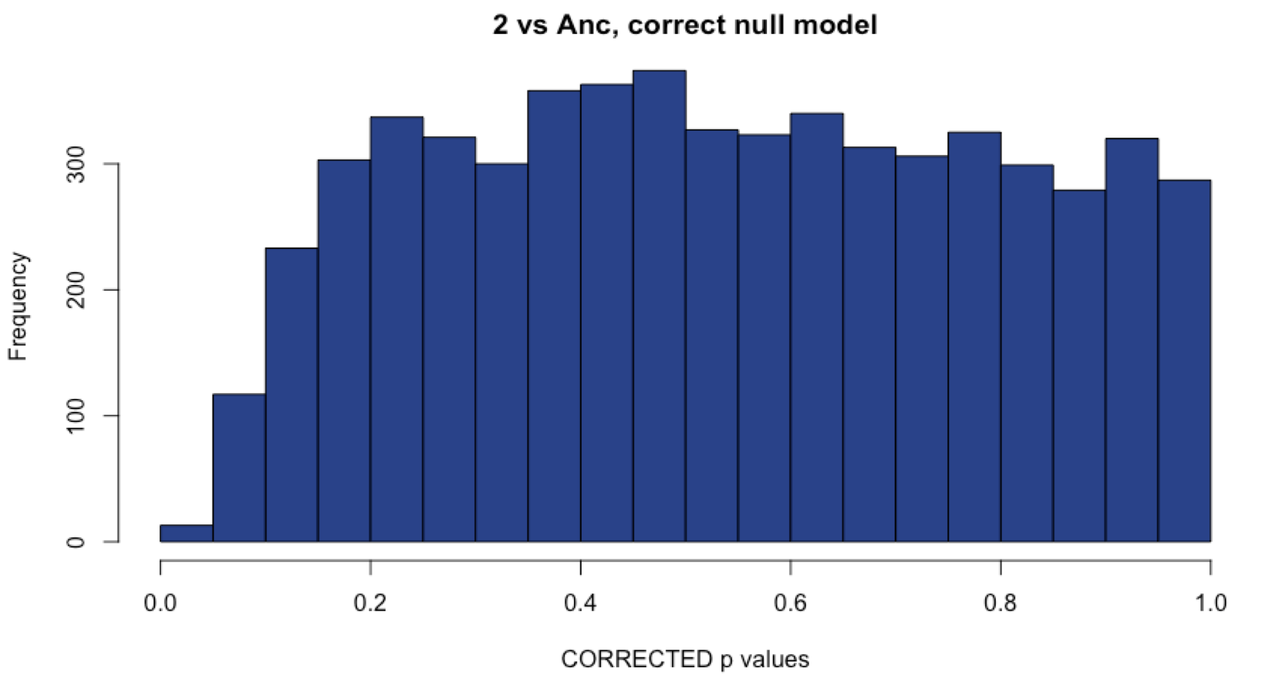
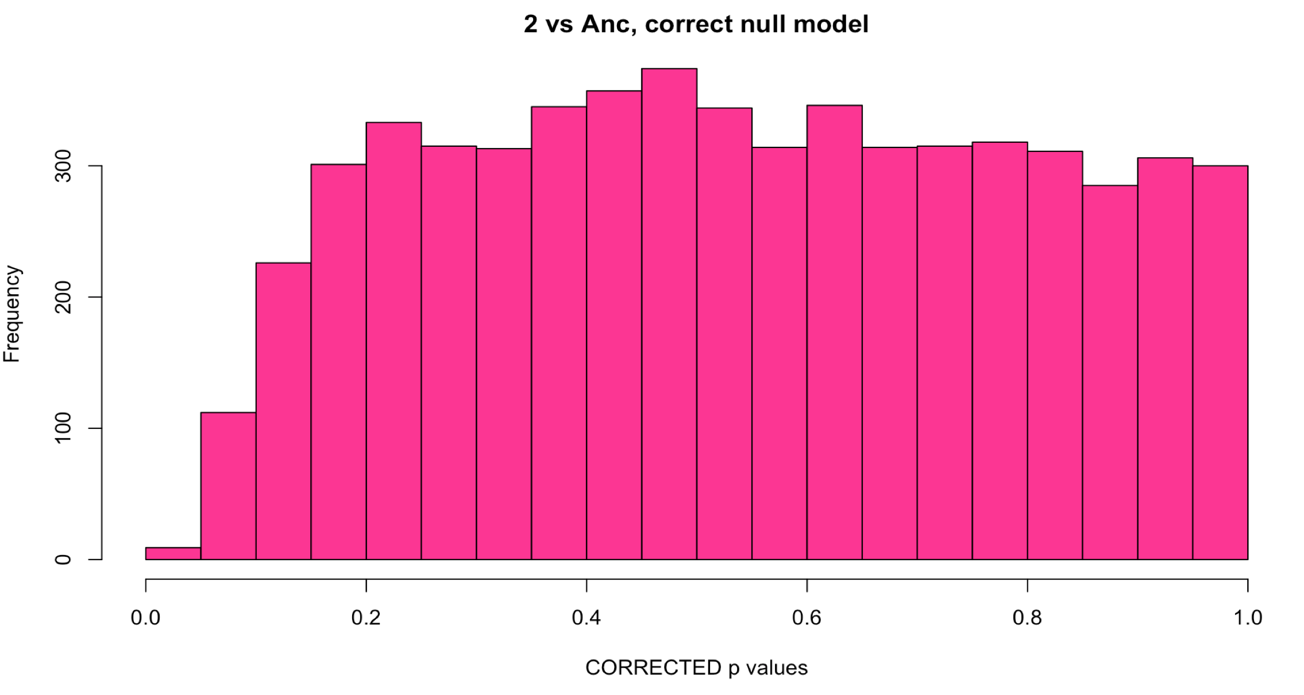
Sample 2: Comparison with methods
WITH Aneuploid C’somes WITHOUT Aneuploid c’somes
# DE: ~900
# DE: ~900
Uncorrected
Corrected with fdrtool
# DE: 0
# DE: 0
Notes:
I am unsure what to do with this sample. 900 DE genes sounds like a lot for a euploid line, but the correction reduces that number to 0.

Slide 11
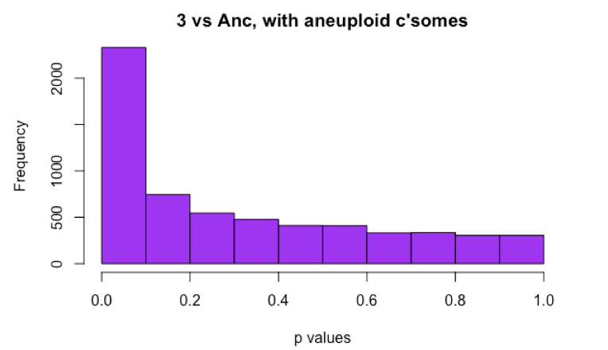
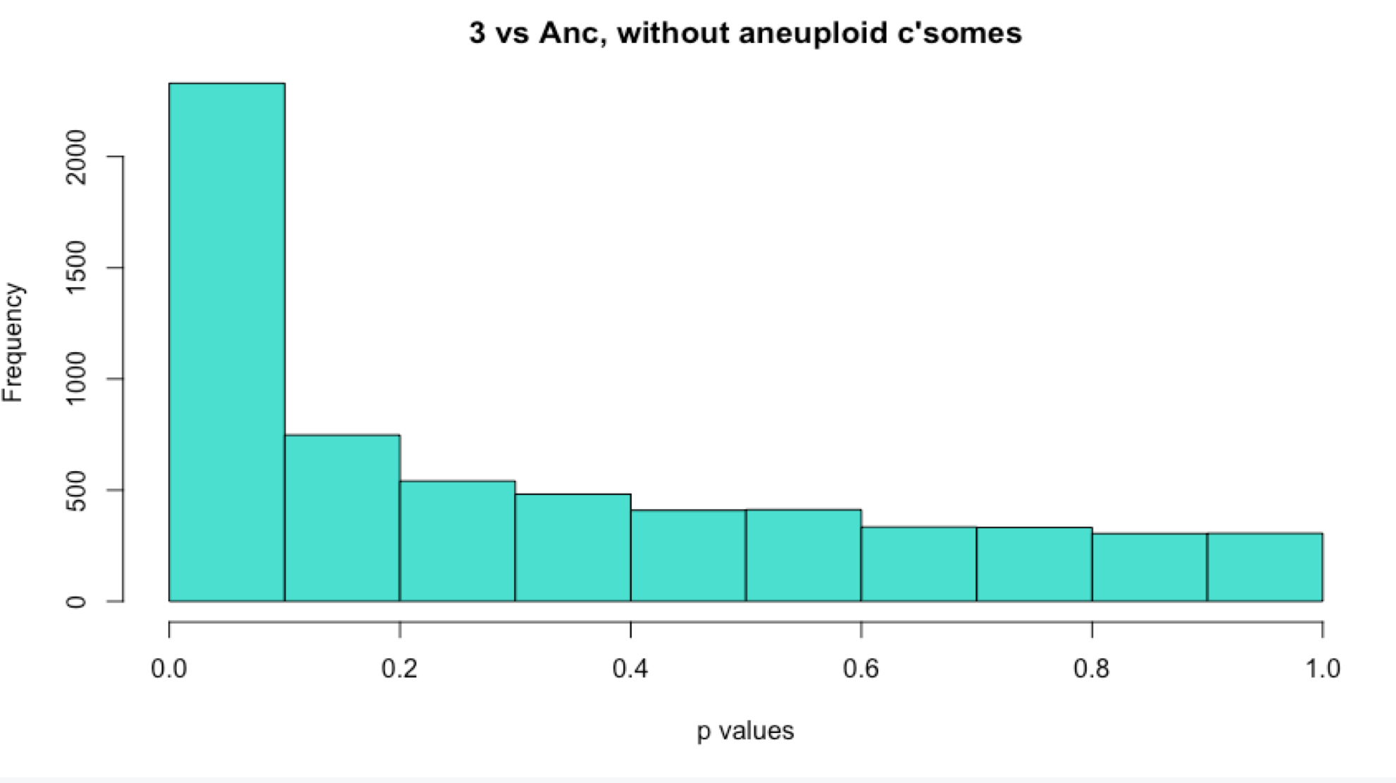
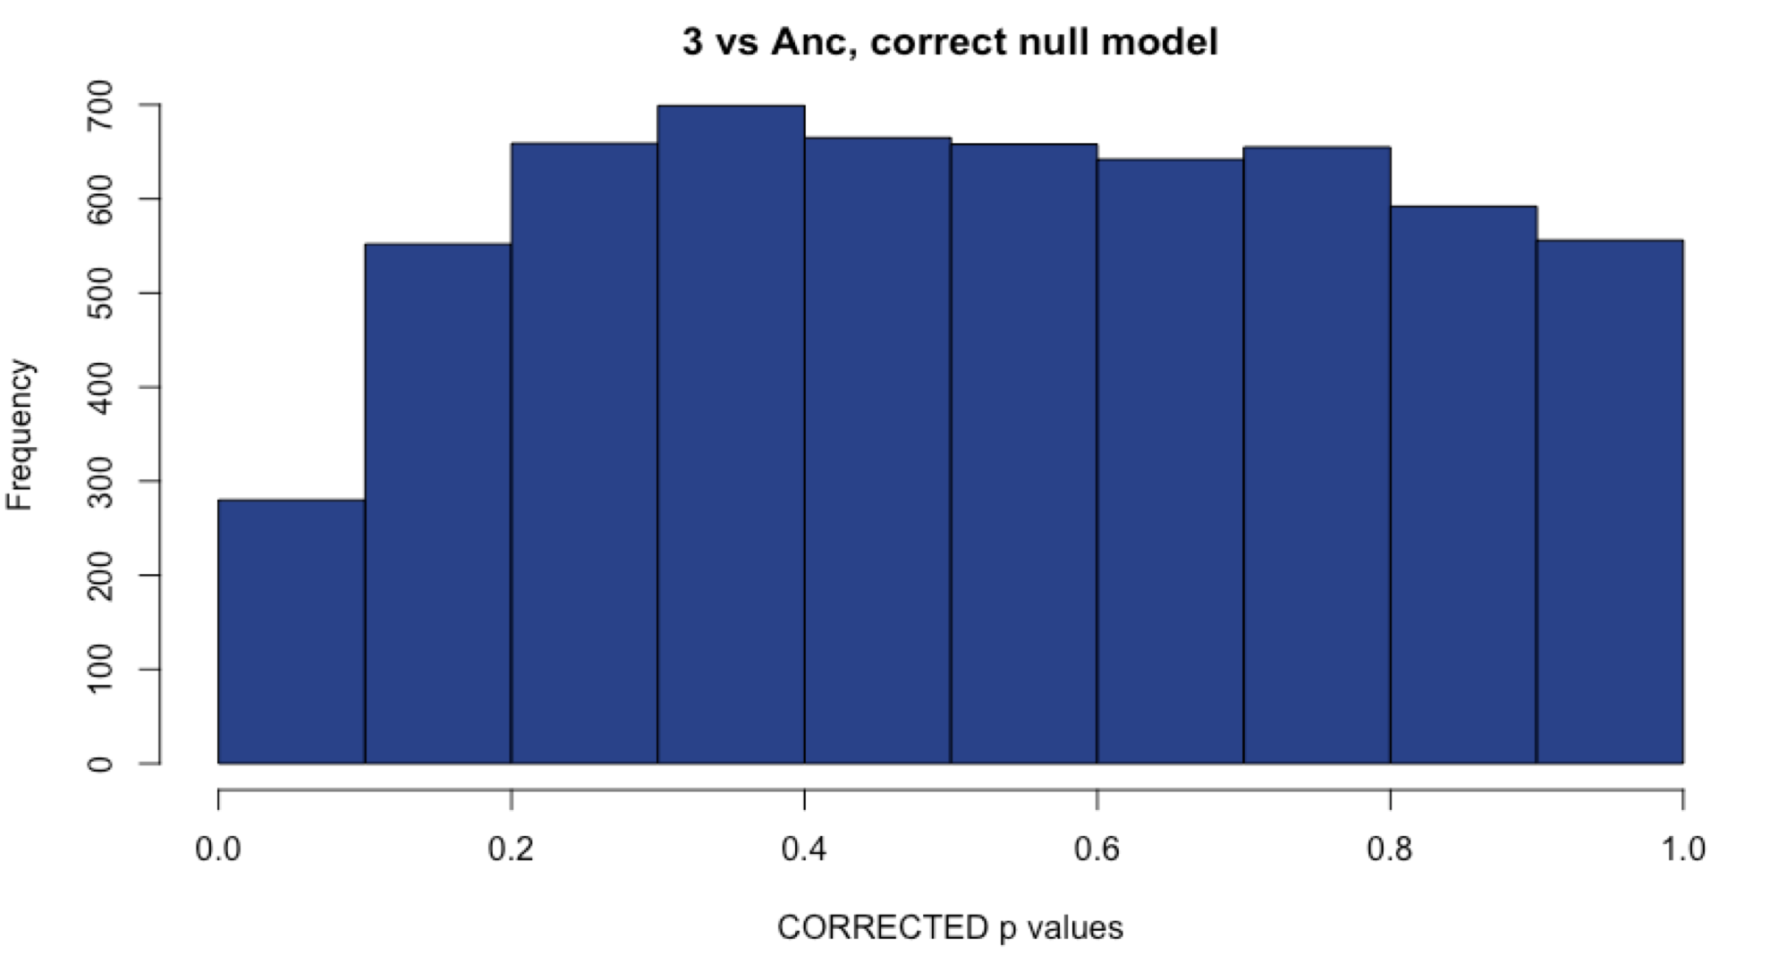
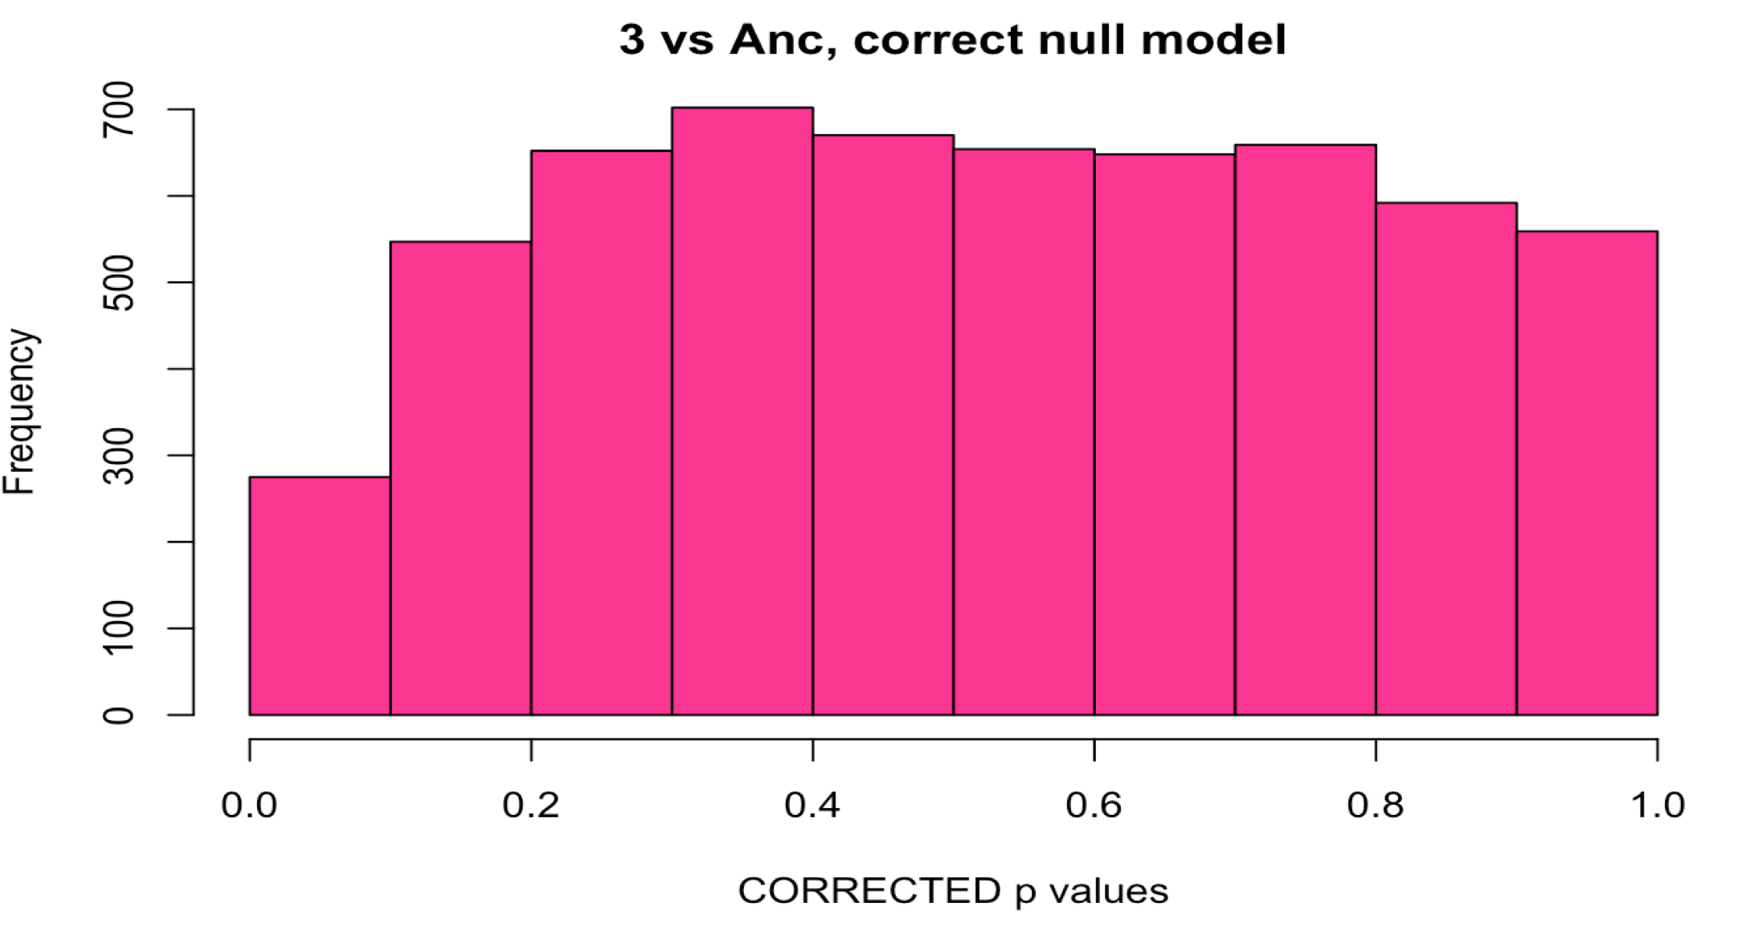
Sample 3: Comparison with methods
WITH Aneuploid C’somes WITHOUT Aneuploid c’somes
# DE: ~1000
# DE: ~1000
Uncorrected
Corrected with fdrtool
# DE: 0
# DE: 0
Notes:
Same as #2

Slide 12
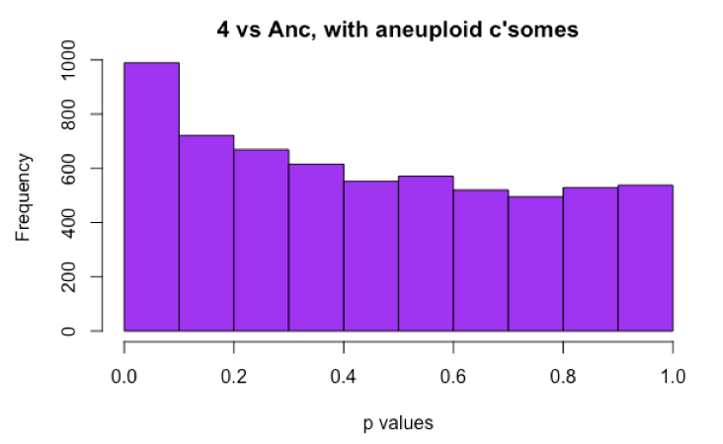
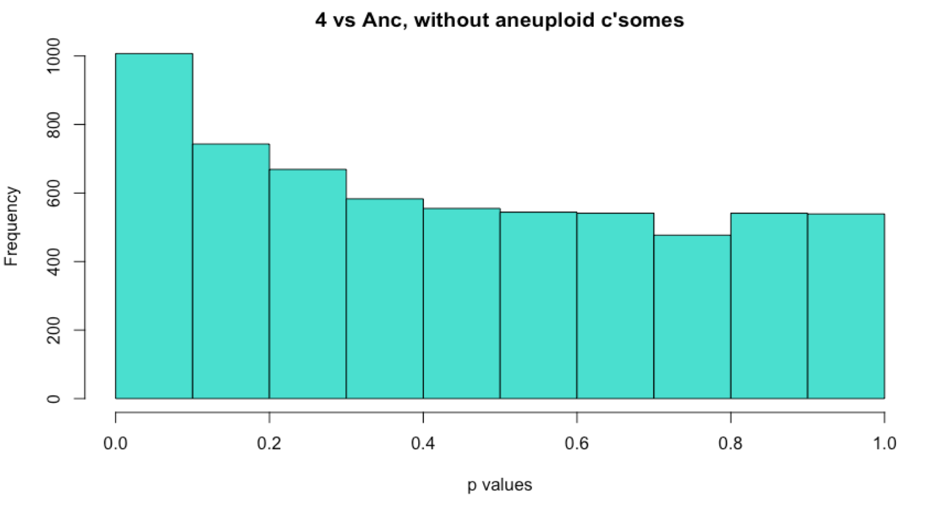
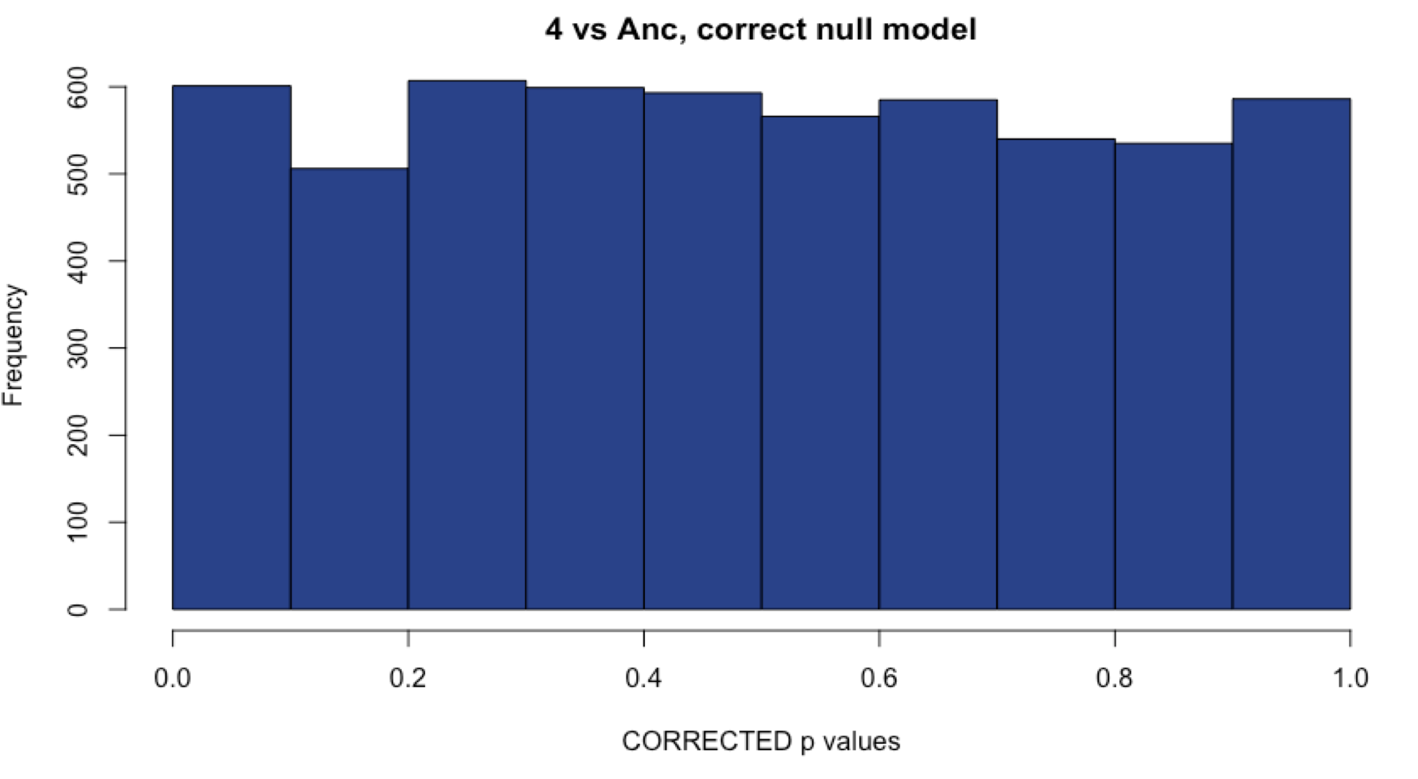
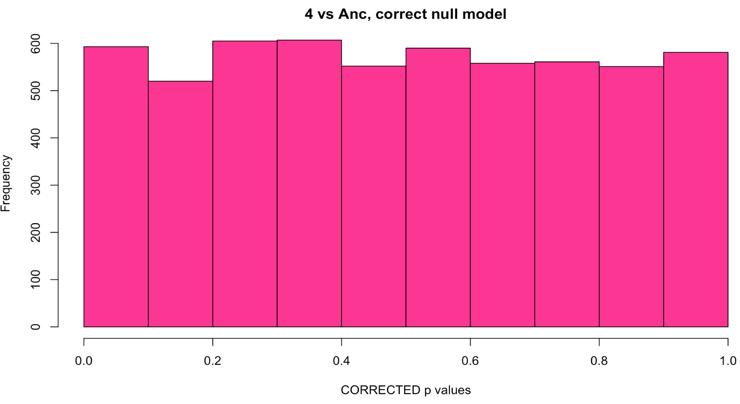
Sample 4: Comparison with methods
WITH Aneuploid C’somes WITHOUT Aneuploid c’somes
# DE: 98
# DE: 120
Uncorrected
Corrected with fdrtool
# DE: 35
# DE: 34
Notes:
Sample 4 is aneuploid, so I chose the method that gave me the most DE genes (and the histogram looks correct).

Slide 13
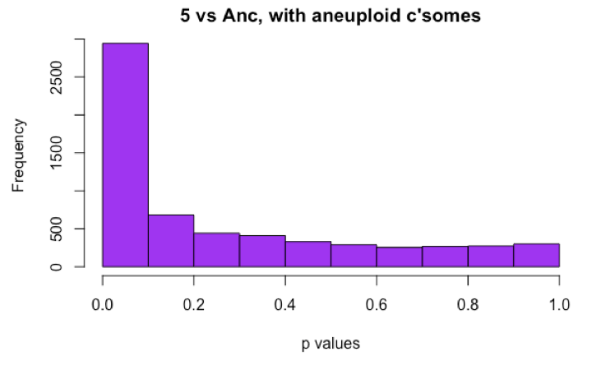
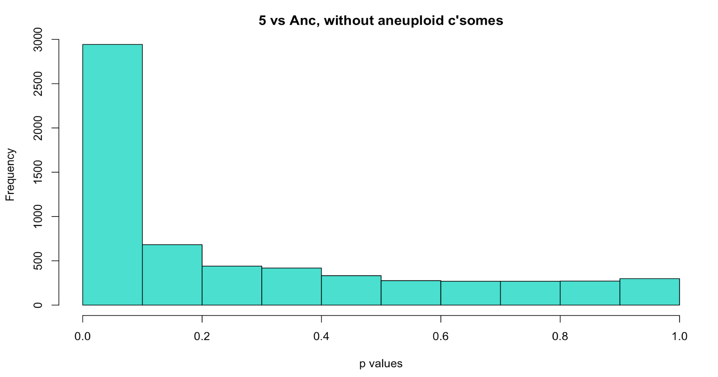
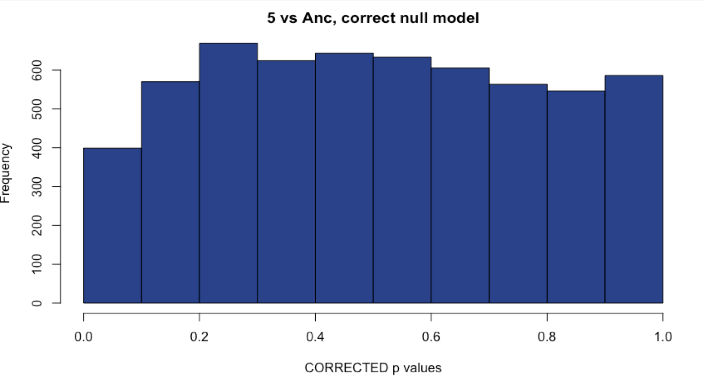
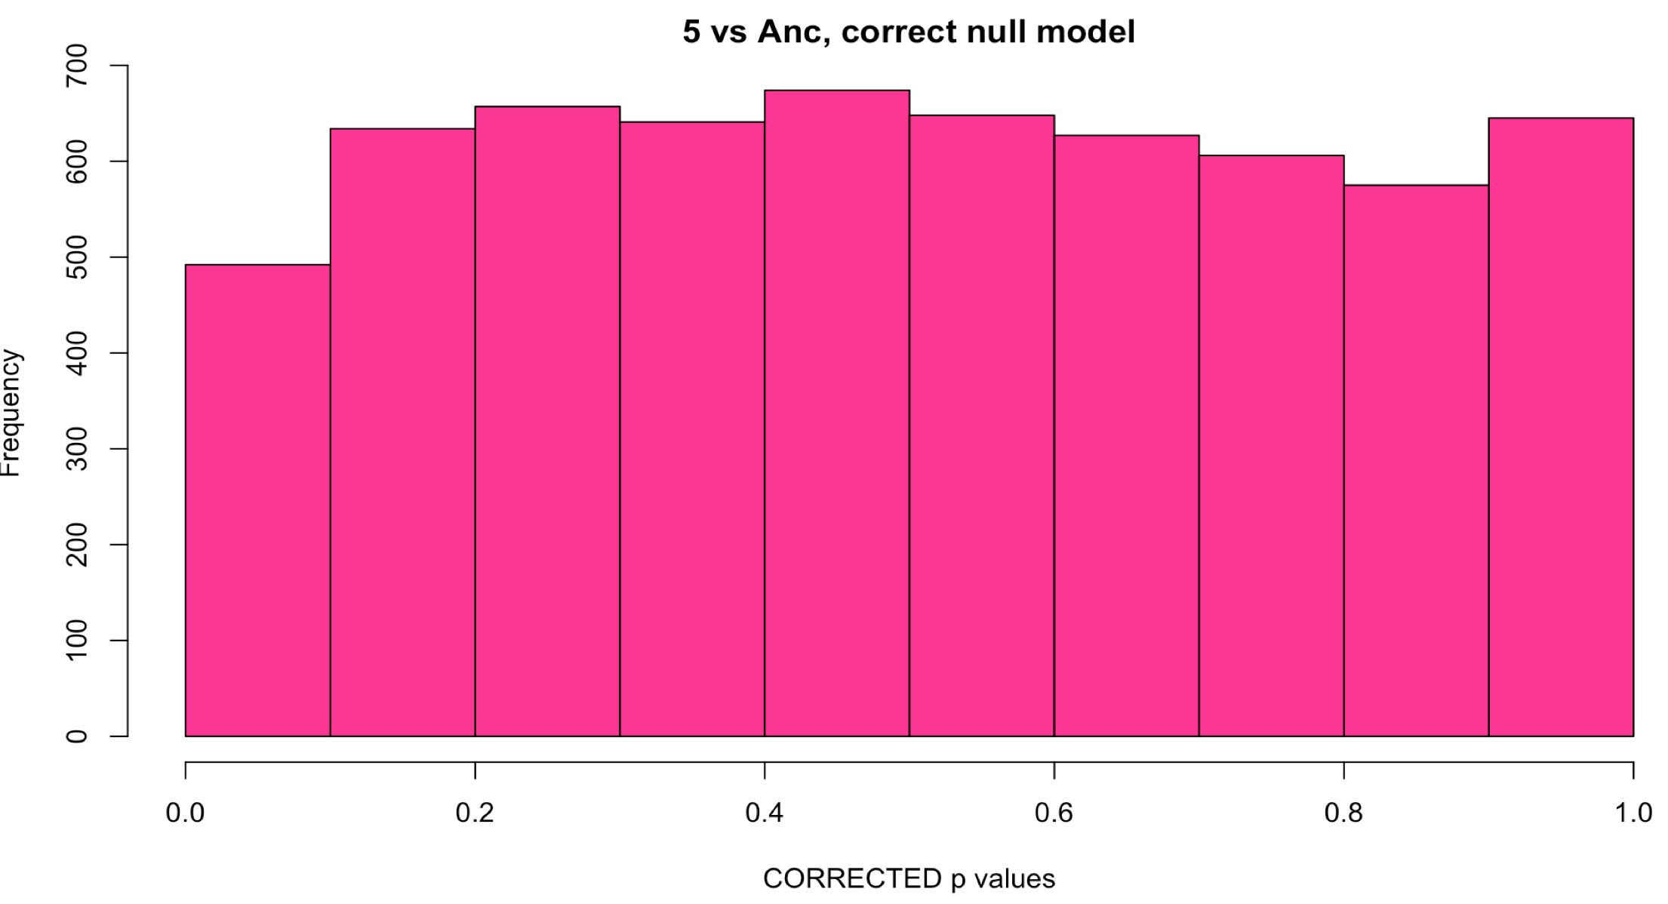
Sample 5: Comparison with methods
WITH Aneuploid C’somes WITHOUT Aneuploid c’somes
# DE: ~2200
# DE: ~2200
Uncorrected
Corrected with fdrtool
# DE: 0
# DE: 0
Notes:
Unsure of what to do here.

Slide 14
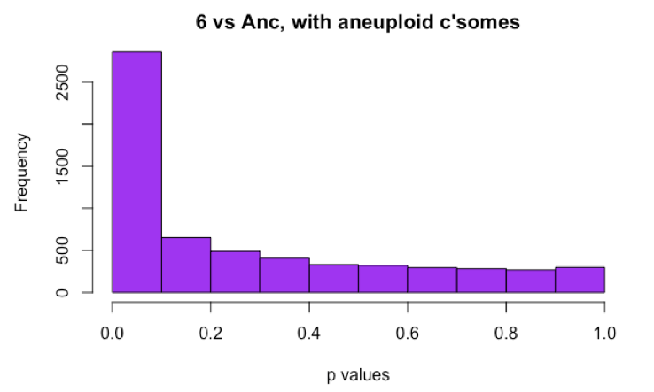
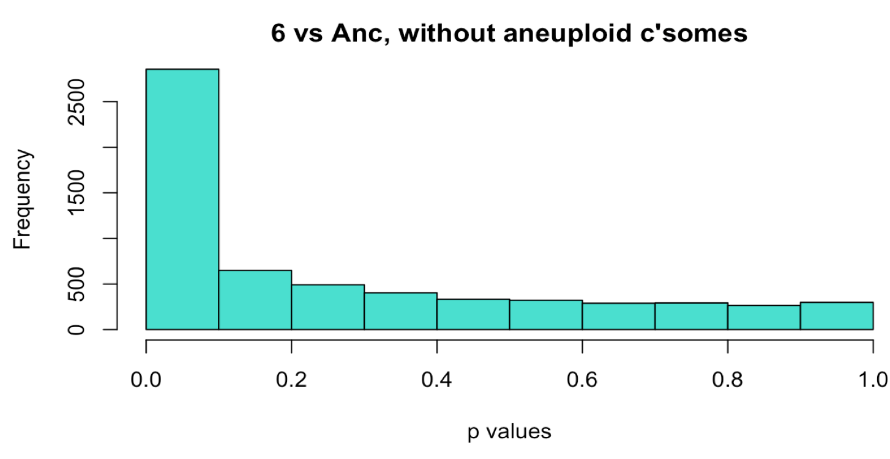
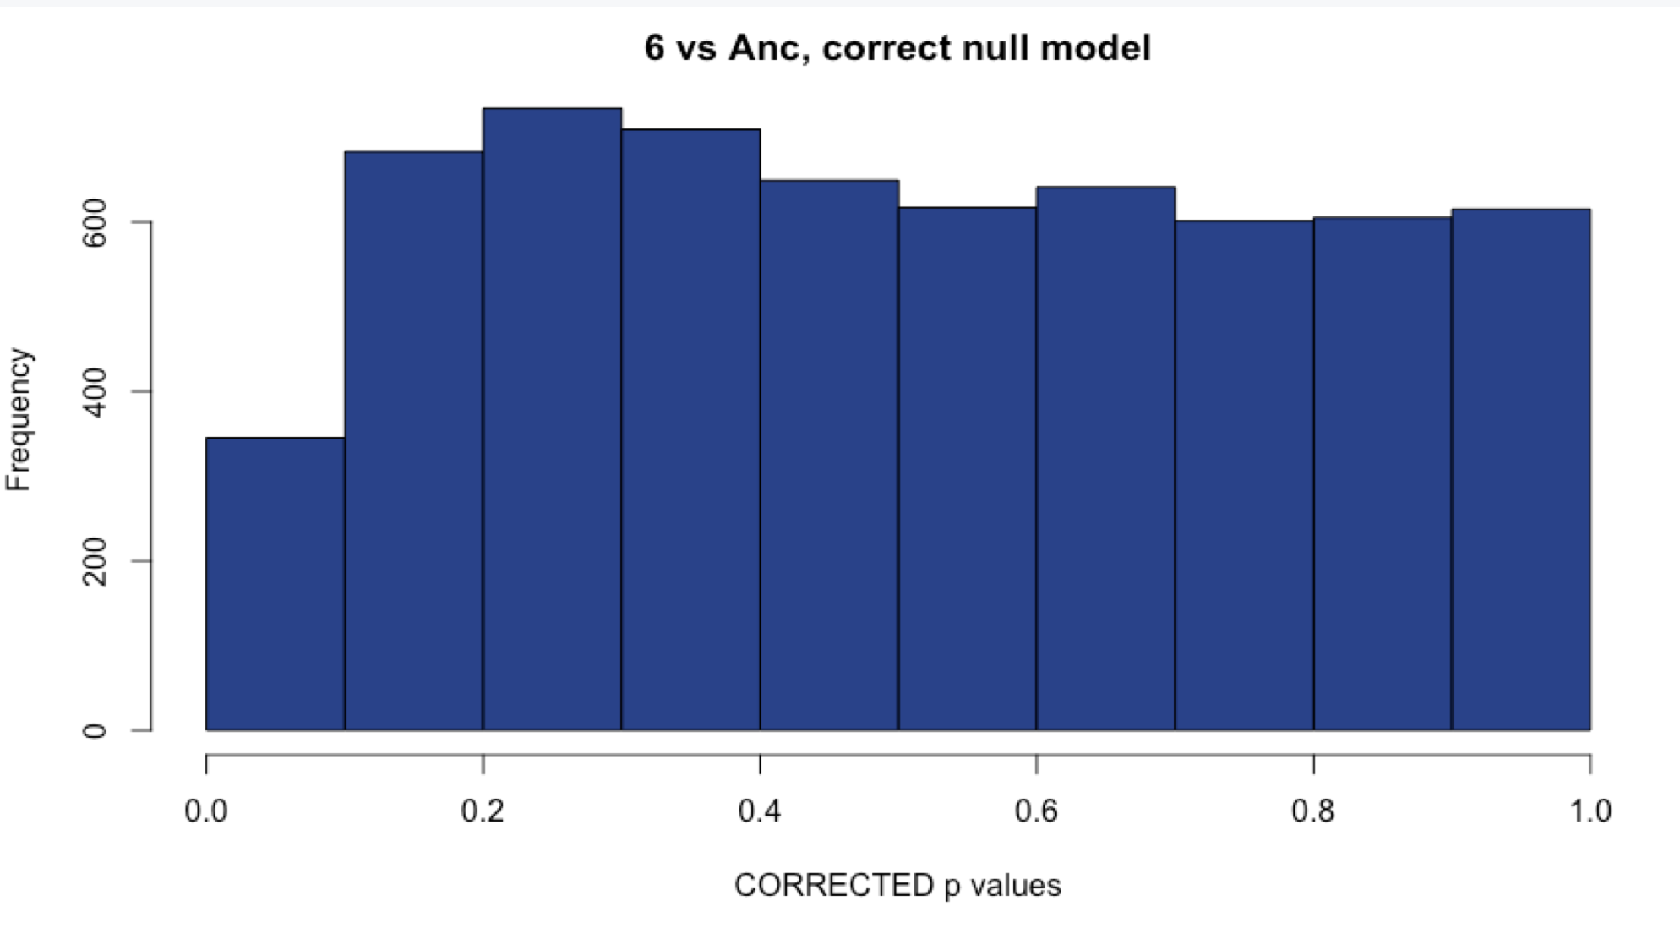
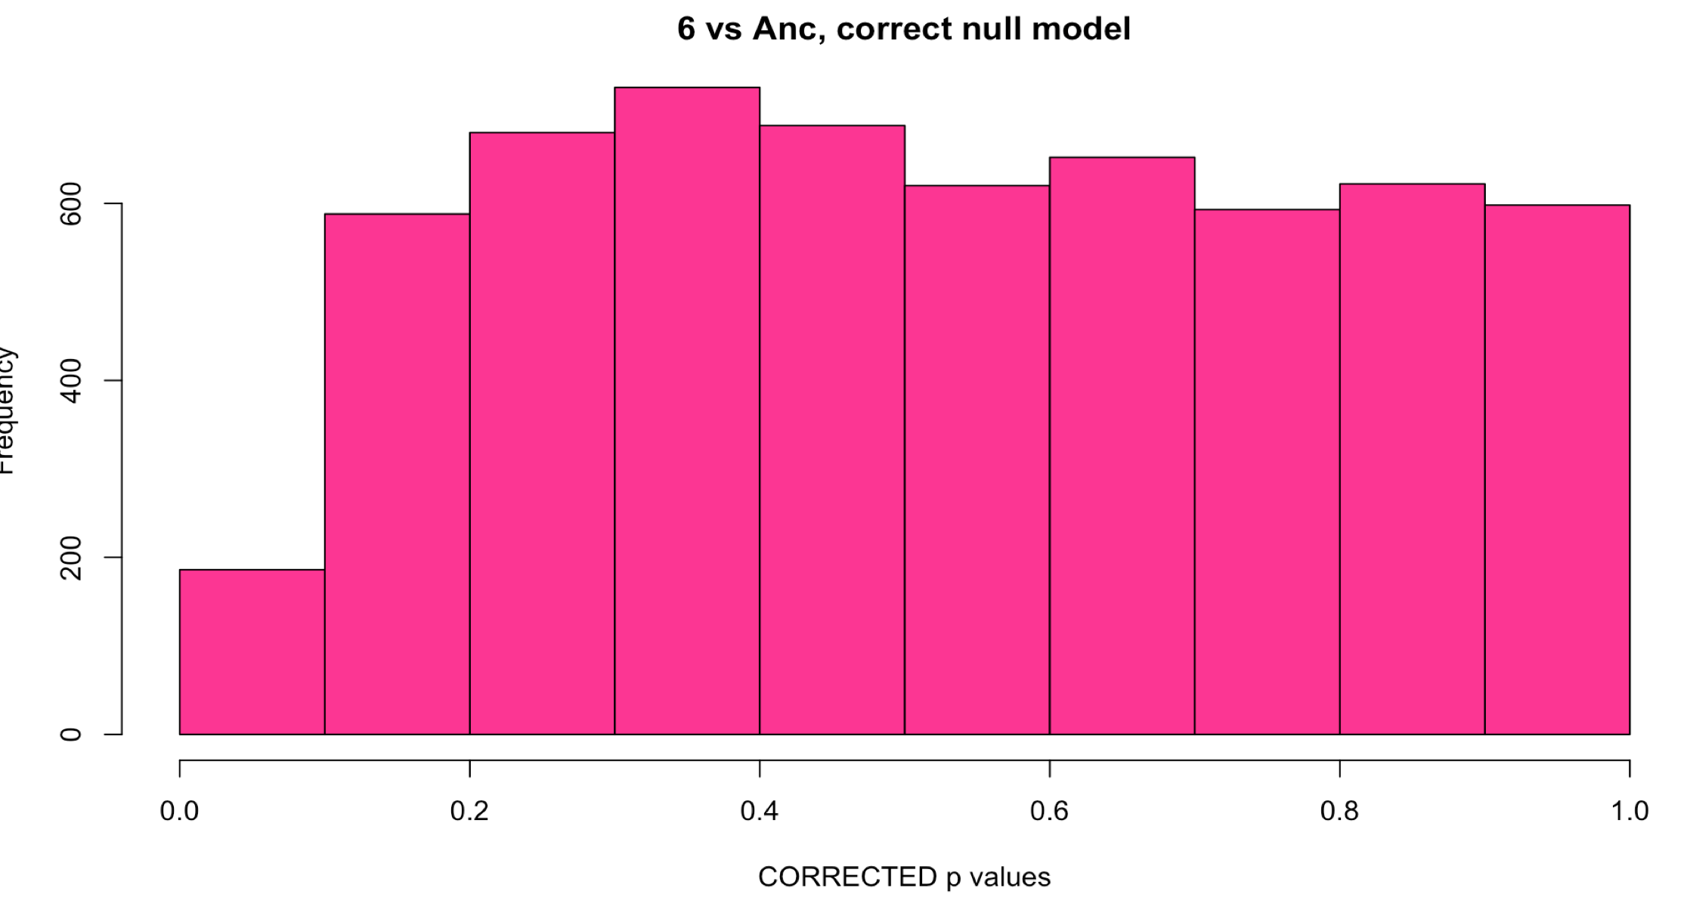
Sample 6: Comparison with methods
WITH Aneuploid C’somes WITHOUT Aneuploid c’somes
# DE: ~2100
# DE: ~2100
Uncorrected
Corrected with fdrtool
# DE: 1
# DE: 0
Notes:
Unsure of what to do here.

Slide 15
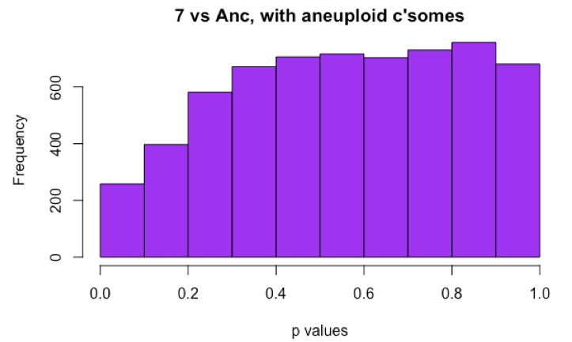
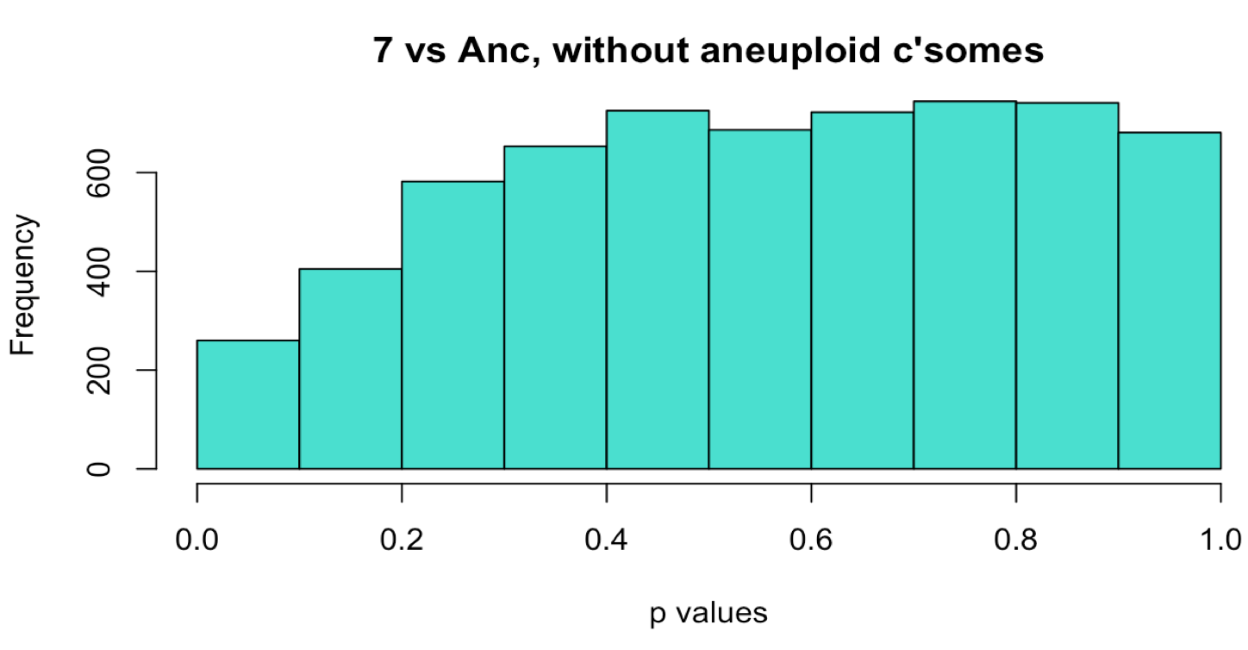
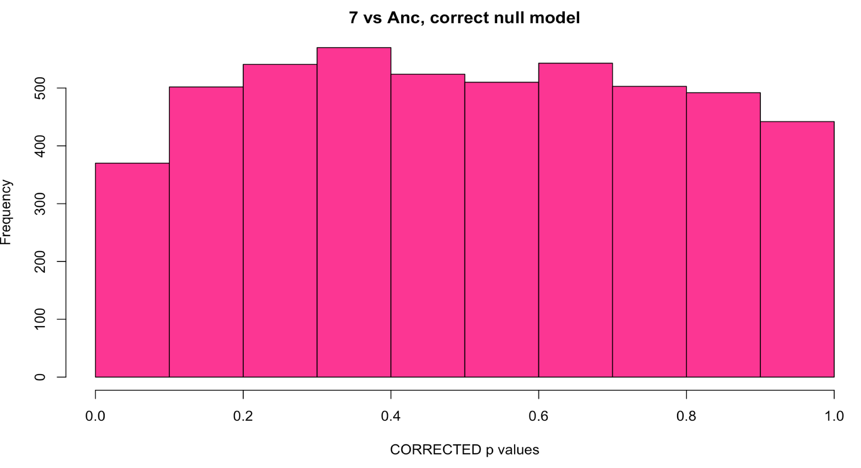
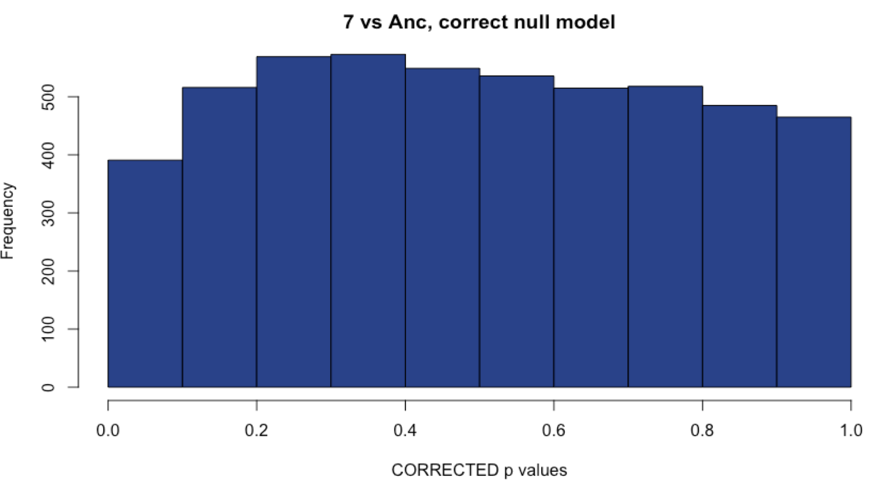
Sample 7: Comparison with methods
WITH Aneuploid C’somes WITHOUT Aneuploid c’somes
# DE: 17
# DE: 19
Uncorrected
Corrected with fdrtool
# DE: 26
# DE: 26
Notes:
Choosing the corrected method since the original has a hill-shaped histogram, and this sample is aneuploid!

Slide 16
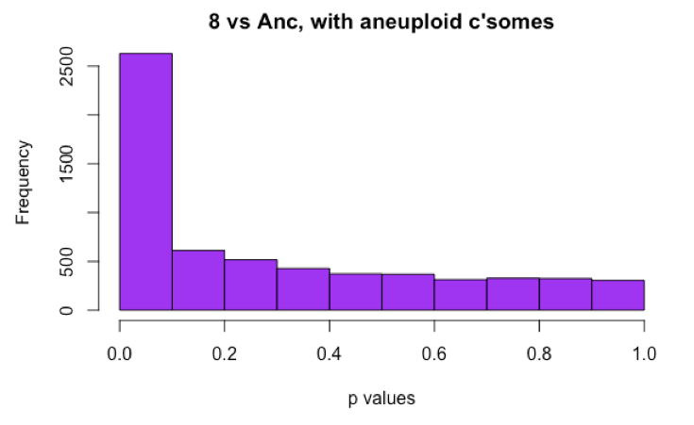

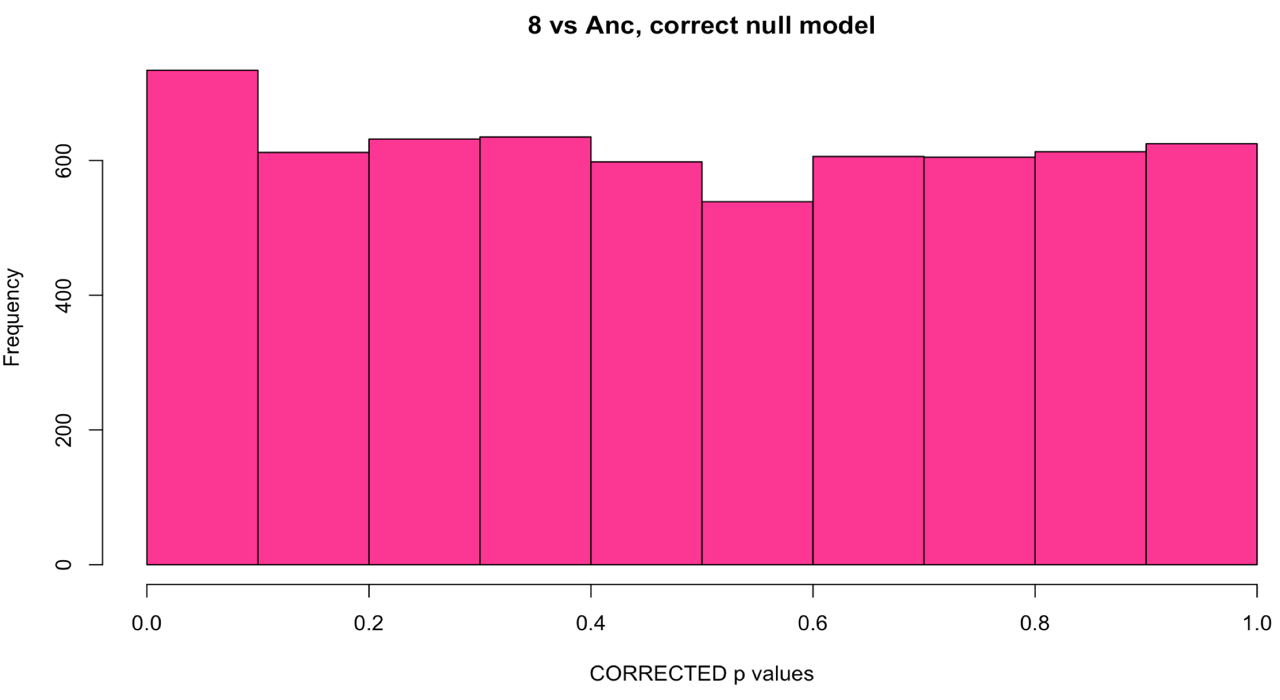
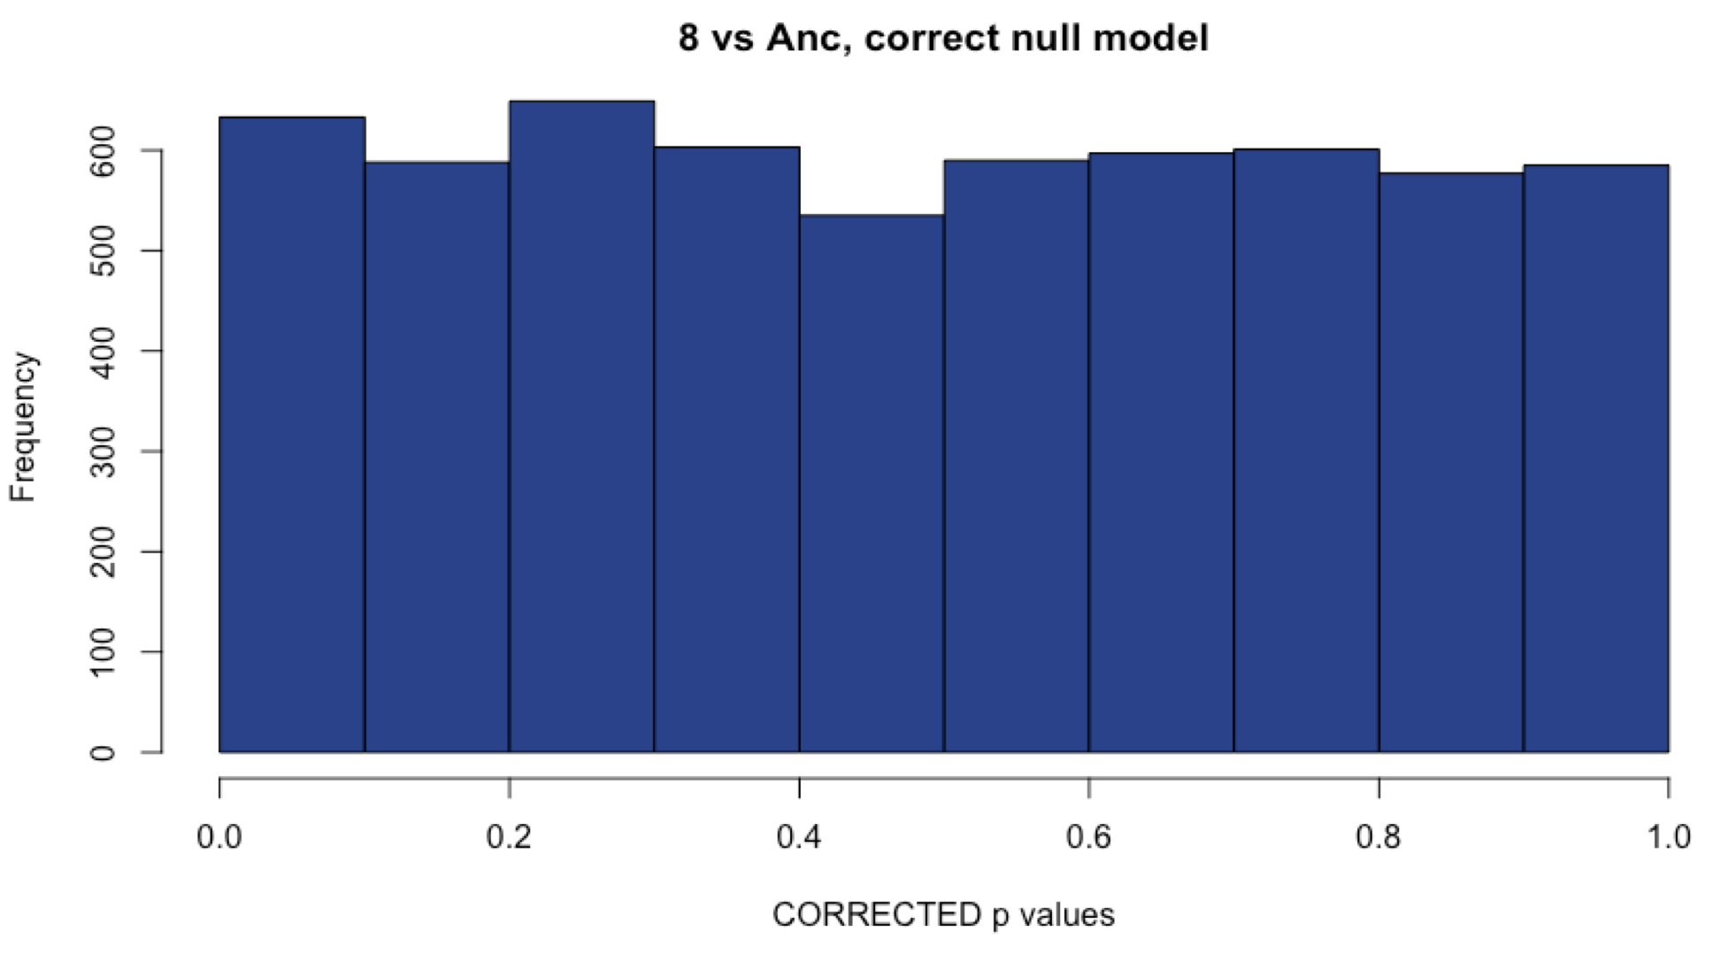
Sample 8: Comparison with methods
WITH Aneuploid C’somes WITHOUT Aneuploid c’somes
# DE: ~1850
# DE: ~1800
Uncorrected
Corrected with fdrtool
# DE: 60
# DE: 102
Notes:
Choosing the uncorrected method, since it gives me the most DE genes, and this line is aneuploid for two different chromosomes (expecting higher numbers of DE genes)

Slide 17
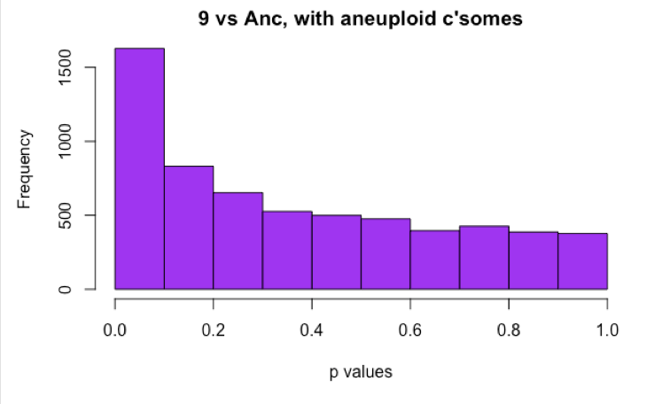
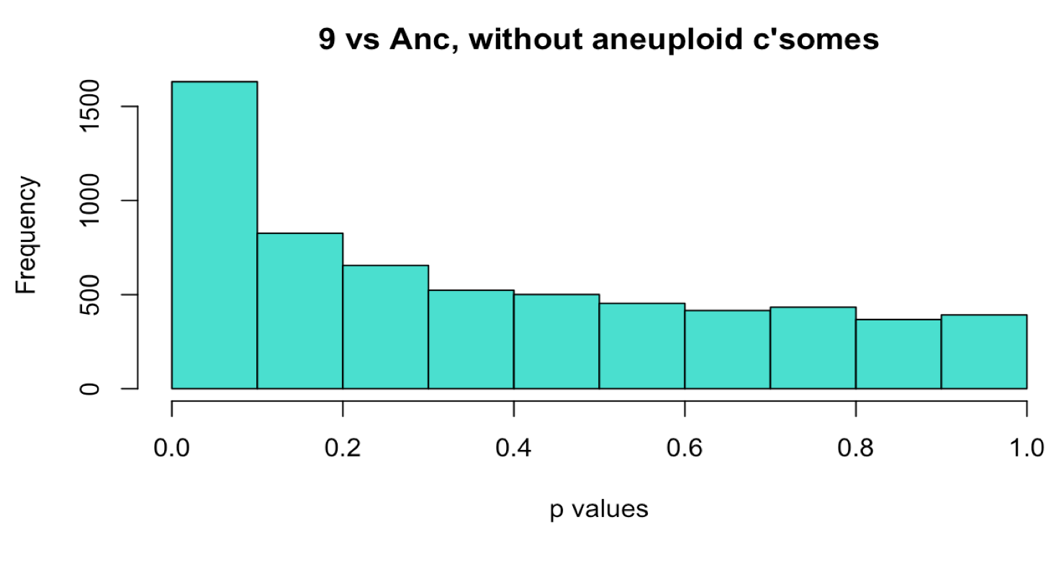
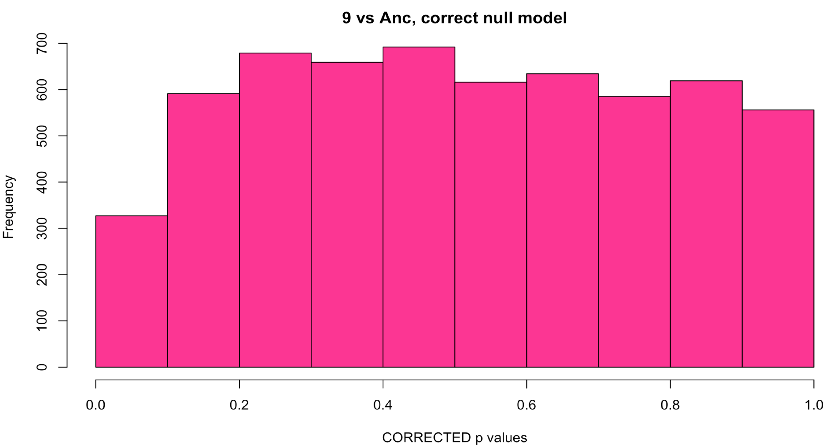
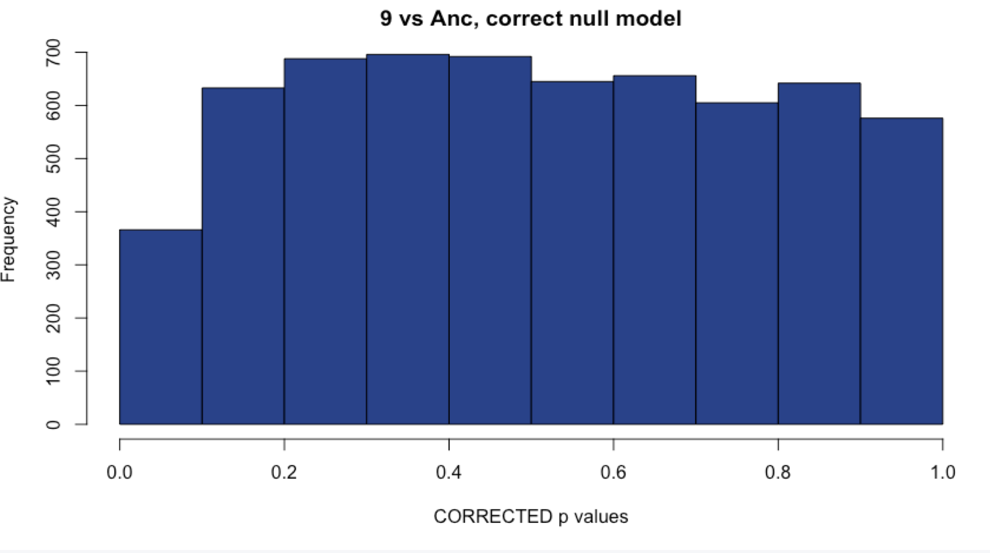
Sample 9: Comparison with methods
WITH Aneuploid C’somes WITHOUT Aneuploid c’somes
# DE: 113
# DE: 119
Uncorrected
Corrected with fdrtool
# DE: 4
# DE: 4
Notes:
Unsure of what to do here

Slide 18
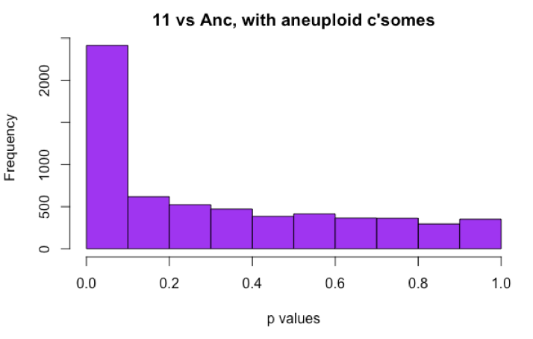
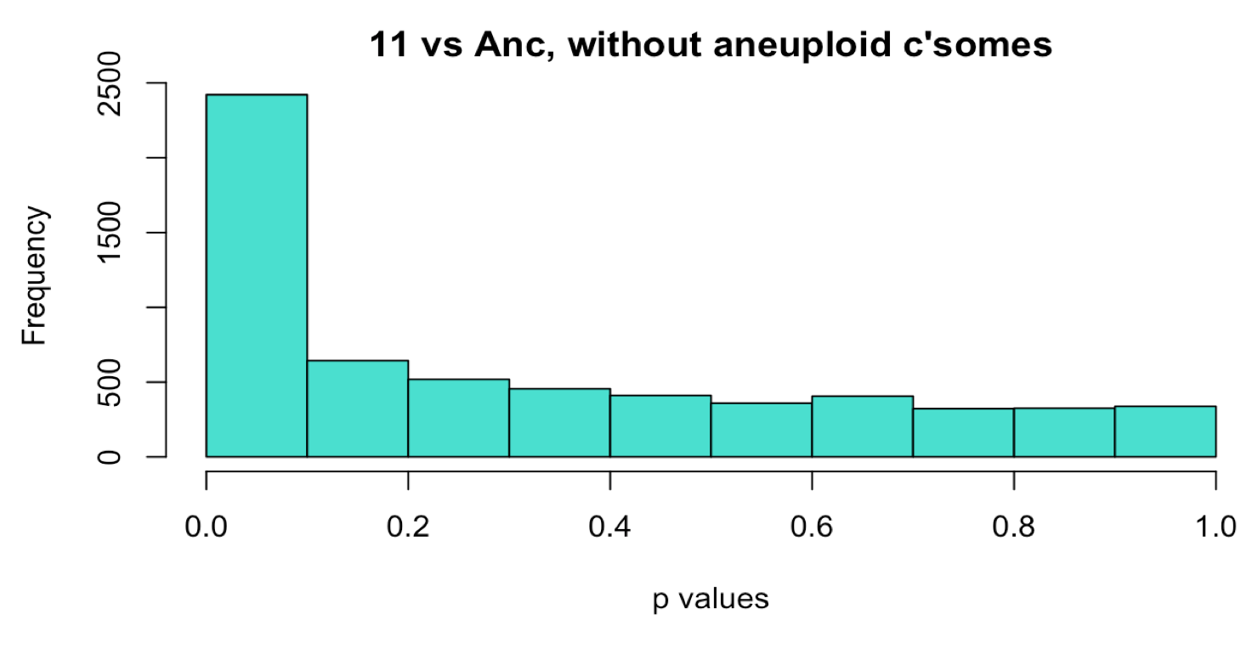
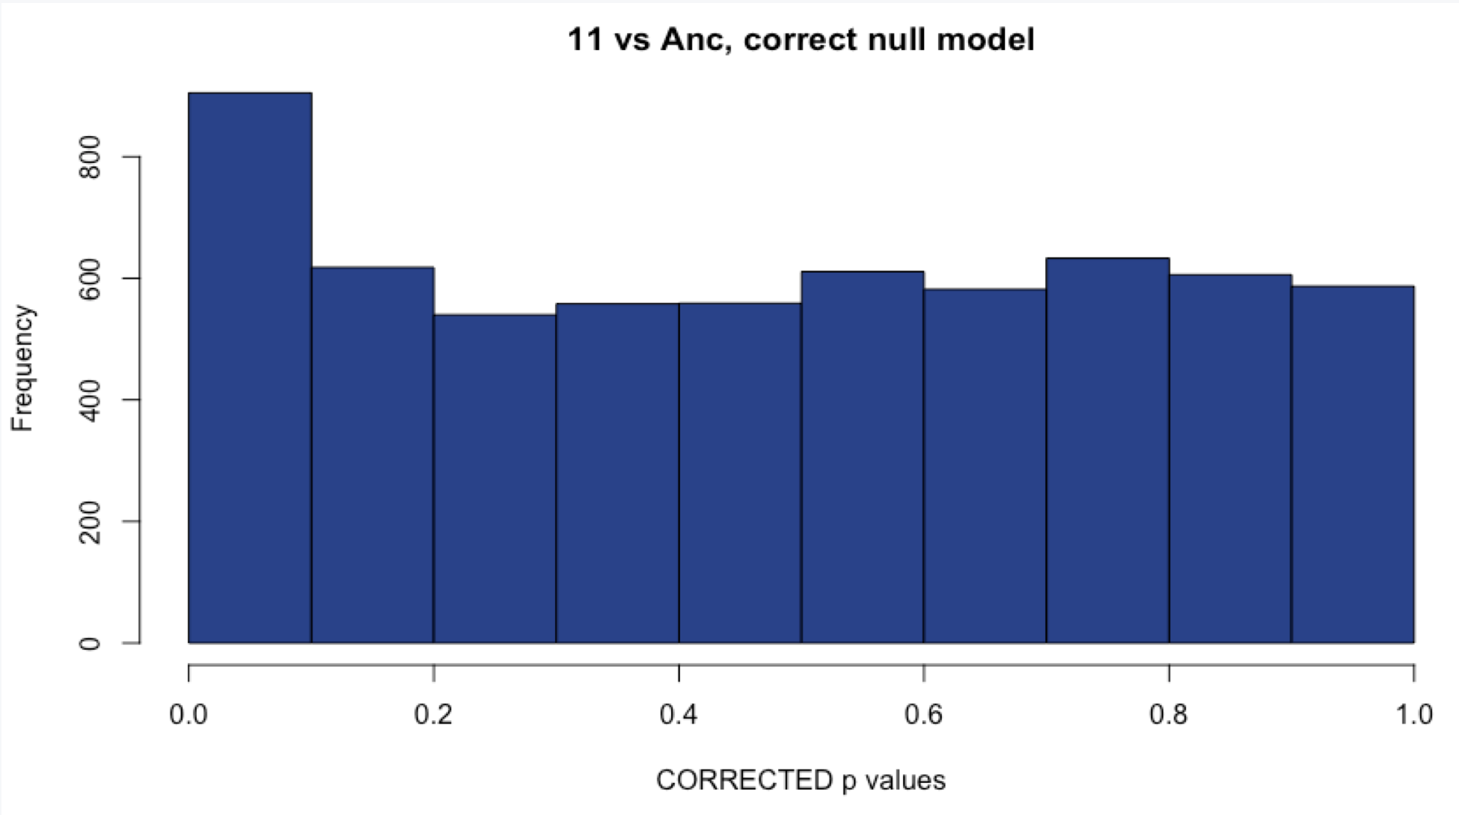
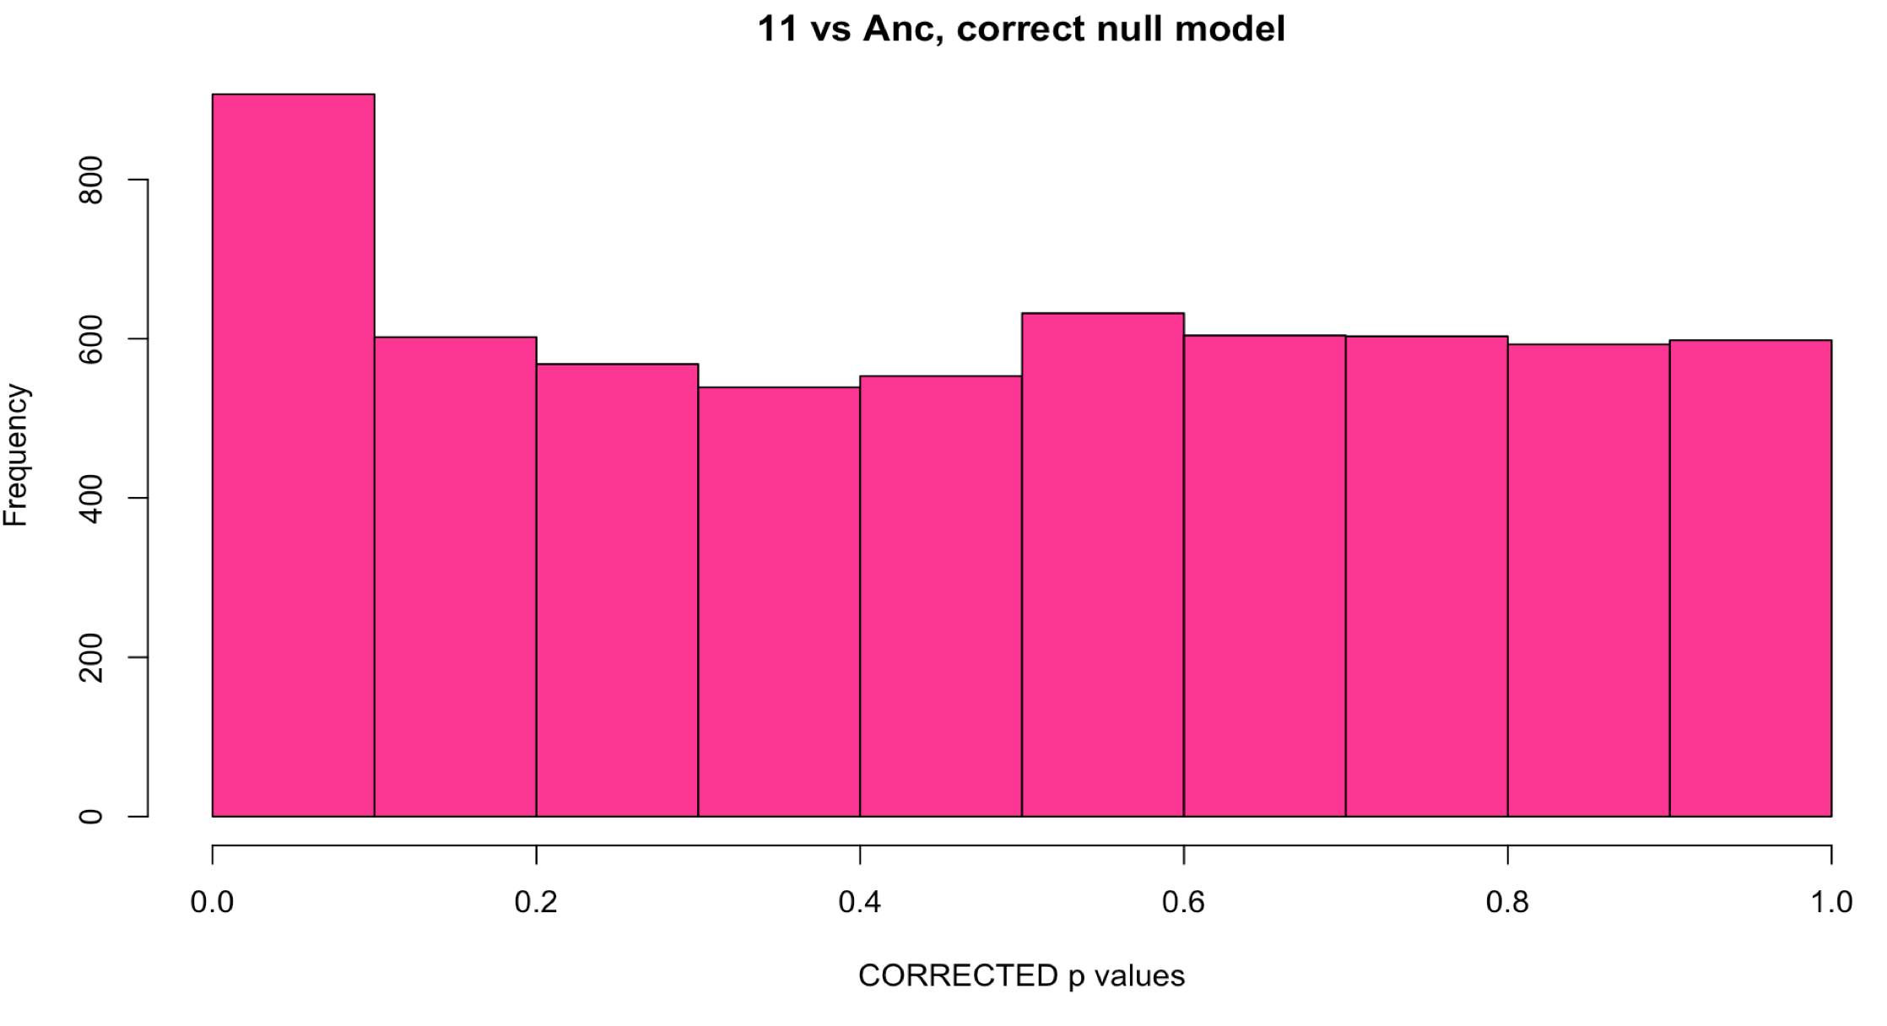
Sample 11: Comparison with methods
WITH Aneuploid C’somes WITHOUT Aneuploid c’somes
# DE: ~1600
# DE: ~1100
Uncorrected
Corrected with fdrtool
# DE: 109
# DE: 108
Notes:
Choosing the uncorrected method, like 18, this sample has two aneuploid chromosomes and I would expect a large number of DE genes.

Slide 19
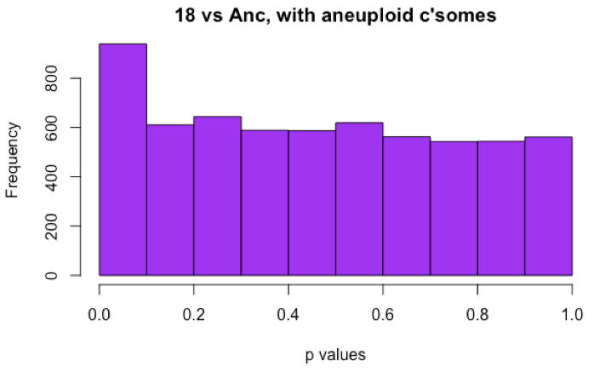
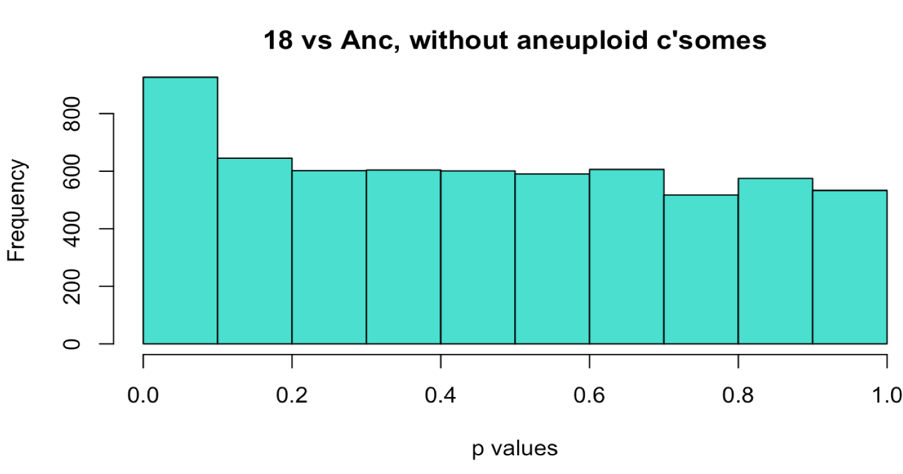
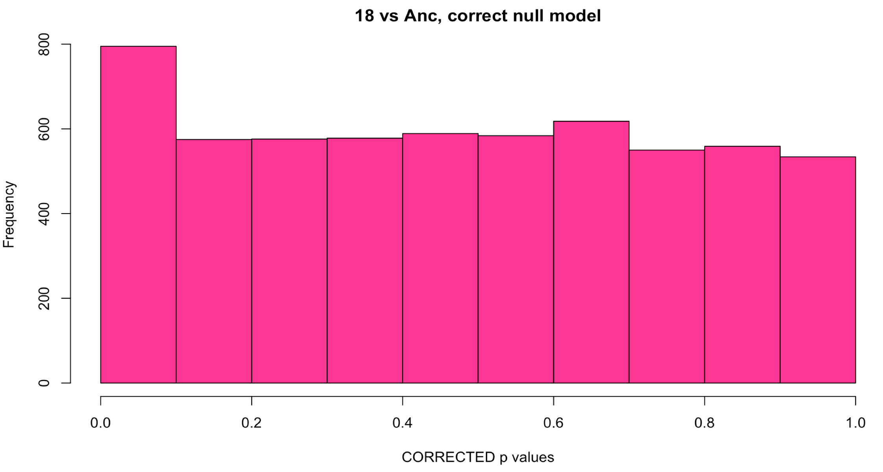
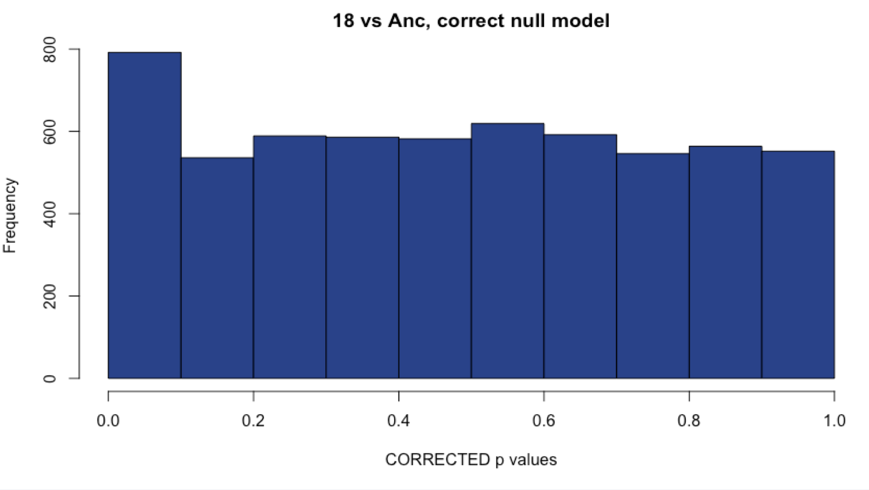
Sample 18: Comparison with methods
WITH Aneuploid C’somes WITHOUT Aneuploid c’somes
# DE: ~200
# DE: 225
Uncorrected
Corrected with fdrtool
# DE: 115
# DE: 155
Notes:
Choosing the uncorrected method, as it is behaving properly and has a large number of DE genes.

Slide 20
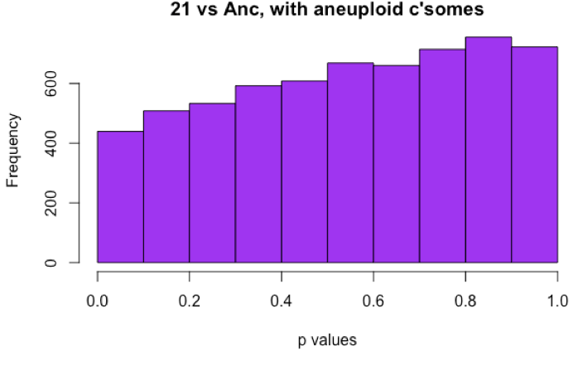
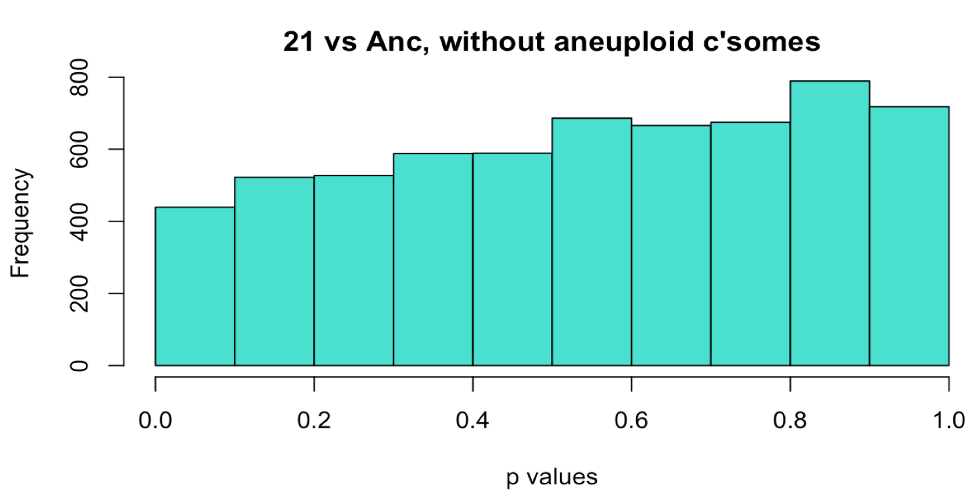
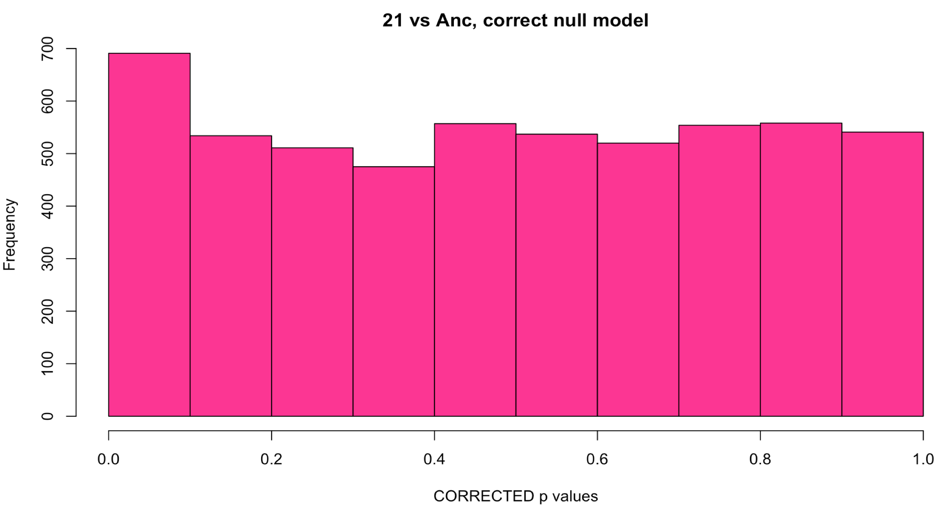
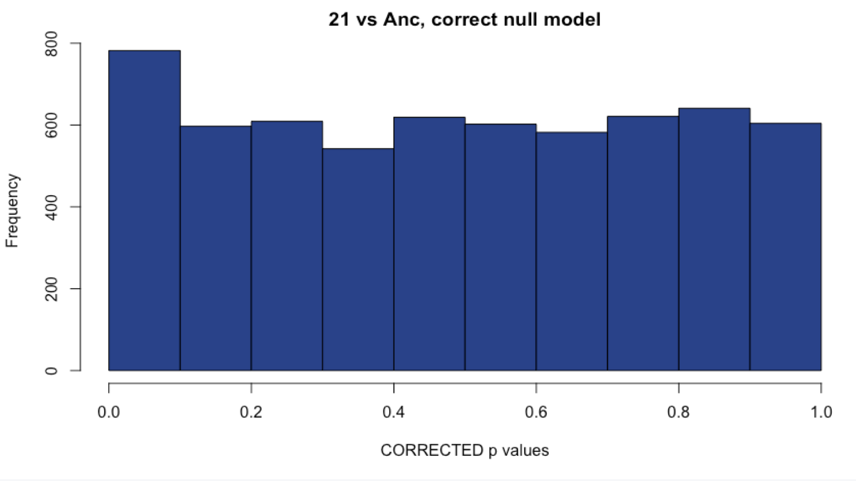
Sample 21: Comparison with methods
WITH Aneuploid C’somes WITHOUT Aneuploid c’somes
# DE: 6
# DE: 13
Uncorrected
Corrected with fdrtool
# DE: 34
# DE: 37
Notes:
Choosing the corrected method, since the histogram before correction hints at a hill-shape and the corrected method gives me more DE genes.

Slide 21
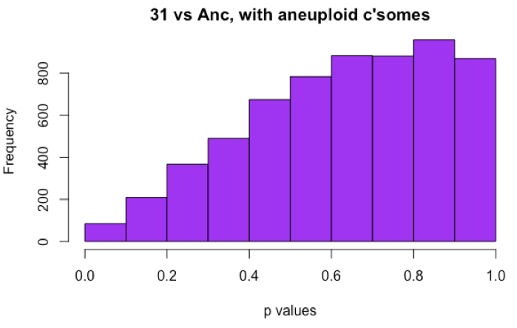
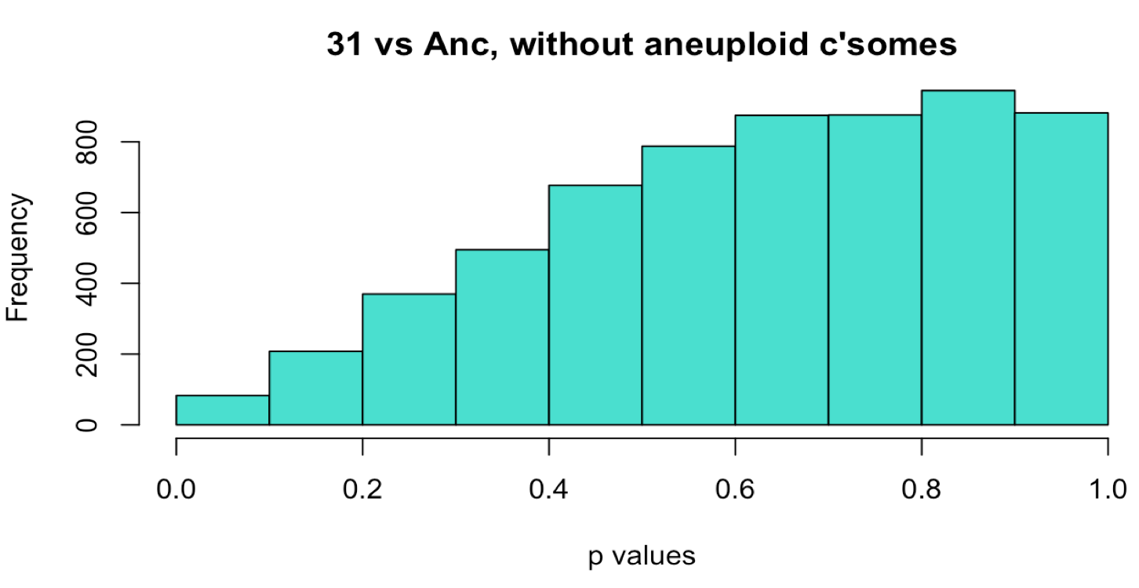
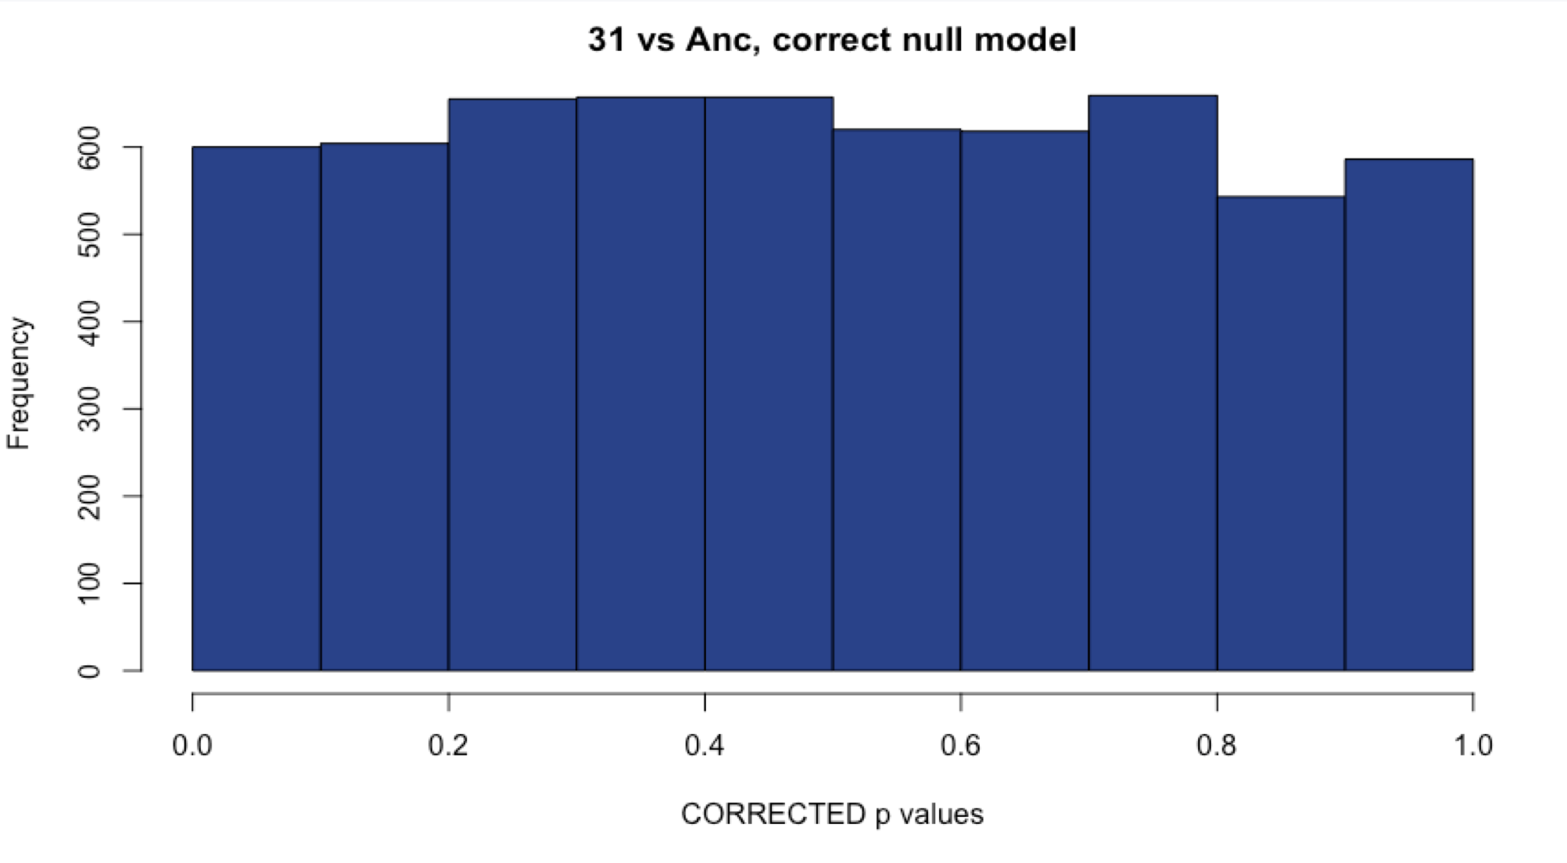

Sample 31: Comparison with methods
WITH Aneuploid C’somes WITHOUT Aneuploid c’somes
# DE: 0
# DE: 0
Uncorrected
Corrected with fdrtool
# DE: 5
# DE: 5
Notes:
Choosing the corrected method, since the original histogram is hill-shaped, and the corrected version gives me 5 DE genes, > 0!

Slide 22




Sample 49: Comparison with methods
WITH Aneuploid C’somes WITHOUT Aneuploid c’somes
# DE: 107
# DE: 109
Uncorrected
Corrected with fdrtool
# DE: 67
# DE: 81
Notes:
Choosing the uncorrected, as the histogram looks fine, and this sample is aneuploid so I expect a lot of DE genes.

Slide 23




Sample 59: Comparison with methods
WITH Aneuploid C’somes WITHOUT Aneuploid c’somes
# DE: 220
# DE: 262
Uncorrected
Corrected with fdrtool
# DE: 129
# DE:194
Notes:
Choosing uncorrected, histogram is fine, aneuploid sample, lots of DE genes

Slide 24




Sample 61: Comparison with methods
WITH Aneuploid C’somes WITHOUT Aneuploid c’somes
# DE: 193
# DE: 221
Uncorrected
Corrected with fdrtool
# DE: 214
# DE: 248
Notes:
Unsure of which to choose here. Aneuploid sample. Both histograms look similar. Just go with corrected to get the most DE genes?

Slide 25




Sample 66: Comparison with methods
WITH Aneuploid C’somes WITHOUT Aneuploid c’somes
# DE: 0
# DE: 2
Uncorrected
Corrected with fdrtool
# DE: 15
# DE: 15
Notes:
Corrected – fixes the hill-shaped histogram and gives us some DE genes

Slide 26




Sample 69: Comparison with methods
WITH Aneuploid C’somes WITHOUT Aneuploid c’somes
# DE: 2
# DE: 2
Uncorrected
Corrected with fdrtool
# DE: 12
# DE: 15
Notes:
Corrected: fixes hill-shaped histogram and gives us DE genes

Slide 27




Sample 76: Comparison with methods
WITH Aneuploid C’somes WITHOUT Aneuploid c’somes
# DE: 250
# DE: 331
Uncorrected
Corrected with fdrtool
# DE: 207
# DE: 252
Notes:
Uncorrected: histogram looks fine, aneuploid sample

Slide 28




Sample 77: Comparison with methods
WITH Aneuploid C’somes WITHOUT Aneuploid c’somes
# DE: 300
# DE: ~300
Uncorrected
Corrected with fdrtool
# DE: 20
# DE: 20
Notes:
Uncorrected, histogram looks fine, aneuploid sample.

Slide 29
Redone without sample 6

Slide 30

Sample 1: Comparison with methods
WITH Aneuploid C’somes WITHOUT Aneuploid c’somes
# DE: 23
# DE: 22
Uncorrected
Corrected with fdrtool
# DE: 0
# DE: 0
Notes:
For ALL OF THEM, I am choosing to exclude the aneuploid chromosomes from the normalization procedure because I believe they will be throwing off my data too much if I leave them in.
Sample 1, I chose uncorrected over corrected because I still obtained some differentially expressed genes, which is not the case for the corrected p values.

Slide 31

Sample 2: Comparison with methods
WITH Aneuploid C’somes WITHOUT Aneuploid c’somes
# DE: ~900
# DE: ~900
Uncorrected
Corrected with fdrtool
# DE: 0
# DE: 0
Notes:
I am unsure what to do with this sample. 900 DE genes sounds like a lot for a euploid line, but the correction reduces that number to 0.

Slide 32

Sample 3: Comparison with methods
WITH Aneuploid C’somes WITHOUT Aneuploid c’somes
# DE: ~1000
# DE: ~1000
Uncorrected
Corrected with fdrtool
# DE: 0
# DE: 0
Notes:
Same as #2

Slide 33

Sample 4: Comparison with methods
WITH Aneuploid C’somes WITHOUT Aneuploid c’somes
# DE: 98
# DE: 120
Uncorrected
Corrected with fdrtool
# DE: 35
# DE: 34
Notes:
Sample 4 is aneuploid, so I chose the method that gave me the most DE genes (and the histogram looks correct).

Slide 34

Sample 5: Comparison with methods
WITH Aneuploid C’somes WITHOUT Aneuploid c’somes
# DE: ~2200
# DE: ~2200
Uncorrected
Corrected with fdrtool
# DE: 0
# DE: 0
Notes:
Unsure of what to do here.

Slide 35

Sample 7: Comparison with methods
WITH Aneuploid C’somes WITHOUT Aneuploid c’somes
# DE: 17
# DE: 19
Uncorrected
Corrected with fdrtool
# DE: 26
# DE: 26
Notes:
Choosing the corrected method since the original has a hill-shaped histogram, and this sample is aneuploid!

Slide 36

Sample 8: Comparison with methods
WITH Aneuploid C’somes WITHOUT Aneuploid c’somes
# DE: ~1850
# DE: ~1800
Uncorrected
Corrected with fdrtool
# DE: 60
# DE: 102
Notes:
Choosing the uncorrected method, since it gives me the most DE genes, and this line is aneuploid for two different chromosomes (expecting higher numbers of DE genes)

Slide 37

Sample 9: Comparison with methods
WITH Aneuploid C’somes WITHOUT Aneuploid c’somes
# DE: 113
# DE: 119
Uncorrected
Corrected with fdrtool
# DE: 4
# DE: 4
Notes:
Unsure of what to do here

Slide 38

Sample 11: Comparison with methods
WITH Aneuploid C’somes WITHOUT Aneuploid c’somes
# DE: ~1600
# DE: ~1100
Uncorrected
Corrected with fdrtool
# DE: 109
# DE: 108
Notes:
Choosing the uncorrected method, like 18, this sample has two aneuploid chromosomes and I would expect a large number of DE genes.

Slide 39

Sample 18: Comparison with methods
WITH Aneuploid C’somes WITHOUT Aneuploid c’somes
# DE: ~200
# DE: 225
Uncorrected
Corrected with fdrtool
# DE: 115
# DE: 155
Notes:
Choosing the uncorrected method, as it is behaving properly and has a large number of DE genes.

Slide 40

Sample 21: Comparison with methods
WITH Aneuploid C’somes WITHOUT Aneuploid c’somes
# DE: 6
# DE: 13
Uncorrected
Corrected with fdrtool
# DE: 34
# DE: 37
Notes:
Choosing the corrected method, since the histogram before correction hints at a hill-shape and the corrected method gives me more DE genes.

Slide 41

Sample 31: Comparison with methods
WITH Aneuploid C’somes WITHOUT Aneuploid c’somes
# DE: 0
# DE: 0
Uncorrected
Corrected with fdrtool
# DE: 5
# DE: 5
Notes:
Choosing the corrected method, since the original histogram is hill-shaped, and the corrected version gives me 5 DE genes, > 0!

Slide 42

Sample 49: Comparison with methods
WITH Aneuploid C’somes WITHOUT Aneuploid c’somes
# DE: 107
# DE: 109
Uncorrected
Corrected with fdrtool
# DE: 67
# DE: 81
Notes:
Choosing the uncorrected, as the histogram looks fine, and this sample is aneuploid so I expect a lot of DE genes.

Slide 43
MA plots: hybrid samples (without sample 6)

Slide 44
Sample 1
Sample 2

Slide 45
Sample 3
Sample 4

Slide 46
Sample 5
Sample 7

Slide 47
Sample 8

Slide 48
Sample 9
Sample 11

Slide 49
Sample 18
Sample 21

Slide 50
Sample 31
Sample 49

Slide 51
Sample 59
Sample 61

Slide 52
Sample 66
Sample 69

Slide 53
Sample 76
Sample 77

Slide 54
Whole-Chromosome Boxplots: Hybrid Samples
Needs to be redone: we removed sample 6 from the analysis

Slide 78
Aneuploidy Project: Correlations Between Different Datasets
Work on finding the correct dataset to use, which corrections to do, etc
For the hybrid samples

Slide 79



Cuffnorm: FPKMs versus counts: aneuploid line
Normalized counts versus fpkms
Average R^2 value: 0.196

Slide 80



Cuffnorm: FPKMs versus counts: euploid line
Average R^2 value: 0.1017

Slide 81

Counts: htseq-count (stranded) versus Rsubread (stranded)
Perfect 1:1 ratio.
Unnormalized

Slide 82



Counts: htseq-count versus Cuffnorm counts
Question: does Cuffnorm normalize the counts in the gene counts table it outputs?

Slide 83



Counts: Rsubread versus Cuffnorm counts

Slide 84

Cufflinks/Cuffnorm: FPKMs from Cufflinks(unstranded) versus FPKMs from Cuffnorm

Slide 85

Cufflinks/Cuffnorm: FPKMs from Cufflinks (first strand) versus FPKMs from Cuffnorm

Slide 86

Cufflinks/Cuffnorm: FPKMs from Cufflinks (second strand) versus FPKMs from Cuffnorm

Slide 87

Cufflinks, default settings (unstranded) by htseq-count, unstranded

Slide 88

Htseq-count unstranded by rsubread, stranded

Slide 89

Cufflinks: gene counts versus htseq-count: unstranded

Slide 90

Cufflinks: gene-counts versus Cufflinks: fpkm

Slide 91




Line 69: Cufflinks gene counts versus htseq-count

Slide 92



Line 21: Cufflinks gene counts versus htseq

Slide 93


Fdrtool: estimate correct null variance for the model
Line 9: Before fdr tool correction
Line 9: After fdr tool correction

Slide 94

Fdrtool: estimate correct null variance for the model
Line 69: Before
Line 69: After

Slide 95
DESeq2: Running analysis with newest parameters
Htseq-count files
Make DESeqDataSet
ddsNoAneu
ddsDef
Analysis with aneuploid chromosomes removed from library normalization
Analysis with all chromosomes
Corrected null model using fdrtool
Default null model variance
Default null model variance
Corrected null model using fdrtool

Slide 96
Analysis with all chromosomes: Default Null Variance
DE genes | Sample 1 | Sample 2 | Sample 3 | Sample 4 | Sample 5 | Sample 6 | Sample 7 | Sample 8 | Sample 9 | Sample 11 | Sample 18
# LFC >0 | 19 | 520 | 626 | 85 | 1099 | 1088 | 16 | 1059 | 92 | 866 | 141
#LFC <0 | 3 | 430 | 469 | 12 | 1085 | 917 | 1 | 750 | 20 | 733 | 29
# outliers | 0 | 0 | 0 | 0 | 0 | 0 | 0 | 0 | 0 | 0 | 0
# low counts | 121 | 363 | 242 | 484 | 242 | 0 | 1088 | 242 | 0 | 0 | 242

Slide 97
Analysis with all chromosomes: Default Null Variance
DE genes | Sample 21 | Sample 31 | Sample 49 | Sample 59 | Sample 61 | Sample 66 | Sample 68 | Sample 76 | Sample 77
# LFC >0 | 5 | 0 | 77 | 208 | 186 | 0 | 0 | 218 | 214
#LFC <0 | 1 | 0 | 30 | 16 | 7 | 0 | 2 | 30 | 81
# outliers | 0 | 0 | 0 | 0 | 0 | 0 | 0 | 0 | 0
# low counts | 0 | 0 | 121 | 121 | 605 | 0 | 0 | 363 | 242

Slide 98
Analysis with aneuploid chromosomes: histograms of p-values

Slide 99
Analysis with aneuploid chromosomes: histograms of p-values

Slide 100
P value histograms: subset the data

Slide 101
Analysis without aneuploid chromosomes: Default Null Variance
DE Genes | Sample 1 | Sample 2 | Sample 3 | Sample 4 | Sample 5 | Sample 6 | Sample 7 | Sample 8 | Sample 9 | Sample 11 | Sample 18
# LFC >0 | 20 | 535 | 629 | 108 | 1110 | 1098 | 18 | 1214 | 105 | 945 | 199
#LFC <0 | 3 | 419 | 469 | 12 | 1083 | 937 | 1 | 604 | 25 | 661 | 21
# outliers | 0 | 0 | 0 | 0 | 0 | 0 | 0 | 0 | 0 | 0 | 0
# low counts | 0 | 363 | 242 | 484 | 363 | 242 | 363 | 242 | 363 | 0 | 0

Slide 102
Analysis without aneuploid chromosomes: Default Null Variance
DE genes | Sample 21 | Sample 31 | Sample 49 | Sample 59 | Sample 61 | Sample 66 | Sample 68 | Sample 76 | Sample 77
# LFC >0 | 13 | 0 | 82 | 255 | 217 | 0 | 0 | 314 | 257
#LFC <0 | 1 | 0 | 27 | 12 | 6 | 0 | 2 | 25 | 49
# outliers | 0 | 0 | 0 | 0 | 0 | 0 | 0 | 0 | 0
# low counts | 0 | 0 | 242 | 242 | 0 | 0 | 0 | 242 | 363

Slide 103
Analysis without aneuploid chromosomes: histograms of p-values

Slide 104
Analysis without aneuploid chromosomes: histograms of p-values

Slide 105
Analysis with all chromosomes: Corrected Null Variance with fdrtool
DE genes | Sample 1 | Sample 2 | Sample 3 | Sample 4 | Sample 5 | Sample 6 | Sample 7 | Sample 8 | Sample 9 | Sample 11 | Sample 18
# LFC >0
#LFC <0
# outliers
# low counts
New sd | 1.16

Slide 106
Analysis with all chromosomes: Corrected Null Variance with fdrtool
DE genes | Sample 21 | Sample 31 | Sample 49 | Sample 59 | Sample 61 | Sample 66 | Sample 68 | Sample 76 | Sample 77
# LFC >0 | 5 | 0 | 77 | 208 | 186 | 0 | 0 | 218 | 214
#LFC <0 | 1 | 0 | 30 | 16 | 7 | 0 | 2 | 30 | 81
# outliers | 0 | 0 | 0 | 0 | 0 | 0 | 0 | 0 | 0
# low counts | 0 | 0 | 121 | 121 | 605 | 0 | 0 | 363 | 242

Slide 107
Analysis without aneuploid chromosomes: Corrected Null Variance with fdrtool
DE Genes | Sample 1 | Sample 2 | Sample 3 | Sample 4 | Sample 5 | Sample 6 | Sample 7 | Sample 8 | Sample 9 | Sample 11 | Sample 18
# LFC >0 | 0 | 0 | 0 | 32 | 0 | 0 | 29 | 81 | 0 | 50 | 133
#LFC <0 | 0 | 0 | 0 | 3 | 0 | 0 | 3 | 2 | 4 | 61 | 10
# outliers | 0 | 0 | 0 | 0 | 0 | 0 | 0 | 0 | 0 | 0 | 0
# low counts | 0 | 0 | 0 | 0 | 0 | 0 | 0 | 0 | 0 | 0 | 0
New sd | 1.158232 | 2.05 | 2.024353 | 1.222808 | 2.4 | 2.4 | 0.8202633 | 2.02 | 1.605019 | 1.8 | 1.08

Slide 108
DE genes | Sample 21 | Sample 31 | Sample 49 | Sample 59 | Sample 61 | Sample 66 | Sample 68 | Sample 76 | Sample 77
# LFC >0 | 33 | 3 | 63 | 177 | 196 | 8 | 8 | 238 | 20
#LFC <0 | 8 | 3 | 17 | 7 | 5 | 6 | 4 | 17 | 0
# outliers | 0 | 0 | 0 | 0 | 0 | 0 | 0 | 0 | 0
# low counts | 0 | 0 | 0 | 0 | 0 | 0 | 0 | 0 | 0
New sd | 0.82 | 0.65 | 1.03 | 1.11 | 1.03 | 0.55 | 0.6499842 | 1.05 | 1.35

Slide 109

Sample 1: Comparison with methods
WITH Aneuploid C’somes WITHOUT Aneuploid c’somes WITHOUT, Corrected

Slide 110
Sample 2: Comparison with methods
WITH Aneuploid C’somes WITHOUT Aneuploid c’somes WITHOUT, Corrected

Slide 111
Sample 3: Comparison with methods
WITH Aneuploid C’somes WITHOUT Aneuploid c’somes WITHOUT, Corrected

Slide 112
Sample 4: Comparison with methods
WITH Aneuploid C’somes WITHOUT Aneuploid c’somes WITHOUT, Corrected PValues

Slide 113
Sample 21: Comparison with methods
WITH Aneuploid C’somes WITHOUT Aneuploid c’somes WITHOUT, Corrected

Slide 114
Sample 69: Comparison with methods
WITH Aneuploid C’somes WITHOUT Aneuploid c’somes WITHOUT, Corrected

Slide 115
The following slides have these properties:
Using full dataset (i.e. all samples, regardless of replicate #)
Using default DESeq parameters
All chromosomes included in normalization
Using default results() function parameters

Slide 116

Sample 1: Comparison with methods
WITH Aneuploid C’somes WITHOUT Aneuploid c’somes
Uncorrected
Corrected with fdrtool

Slide 117
Sample 2: Comparison with methods
WITH Aneuploid C’somes WITHOUT Aneuploid c’somes
Uncorrected
Corrected with fdrtool

Slide 118
Sample 3: Comparison with methods
WITH Aneuploid C’somes WITHOUT Aneuploid c’somes
Uncorrected
Corrected with fdrtool

Slide 119
Sample 4: Comparison with methods
WITH Aneuploid C’somes WITHOUT Aneuploid c’somes
Uncorrected
Corrected with fdrtool

Slide 120
Sample 5: Comparison with methods
WITH Aneuploid C’somes WITHOUT Aneuploid c’somes
Uncorrected
Corrected with fdrtool

Slide 121
Sample 6: Comparison with methods
WITH Aneuploid C’somes WITHOUT Aneuploid c’somes
Uncorrected
Corrected with fdrtool

Slide 122
Sample 7: Comparison with methods
WITH Aneuploid C’somes WITHOUT Aneuploid c’somes
Uncorrected
Corrected with fdrtool

Slide 123
Sample 8: Comparison with methods
WITH Aneuploid C’somes WITHOUT Aneuploid c’somes
Uncorrected
Corrected with fdrtool

Slide 124
Sample 9: Comparison with methods
WITH Aneuploid C’somes WITHOUT Aneuploid c’somes
Uncorrected
Corrected with fdrtool

Slide 125
Sample 11: Comparison with methods
WITH Aneuploid C’somes WITHOUT Aneuploid c’somes
Uncorrected
Corrected with fdrtool

Slide 126
Sample 18: Comparison with methods
WITH Aneuploid C’somes WITHOUT Aneuploid c’somes
Uncorrected
Corrected with fdrtool

Slide 127
Sample 21: Comparison with methods
WITH Aneuploid C’somes WITHOUT Aneuploid c’somes
Uncorrected
Corrected with fdrtool

Slide 128
Sample 31: Comparison with methods
WITH Aneuploid C’somes WITHOUT Aneuploid c’somes
Uncorrected
Corrected with fdrtool

Slide 129
Sample 49: Comparison with methods
WITH Aneuploid C’somes WITHOUT Aneuploid c’somes
Uncorrected
Corrected with fdrtool

Slide 130
Sample 59: Comparison with methods
WITH Aneuploid C’somes WITHOUT Aneuploid c’somes
Uncorrected
Corrected with fdrtool

Slide 131
Sample 61: Comparison with methods
WITH Aneuploid C’somes WITHOUT Aneuploid c’somes
Uncorrected
Corrected with fdrtool

Slide 132
Sample 66: Comparison with methods
WITH Aneuploid C’somes WITHOUT Aneuploid c’somes
Uncorrected
Corrected with fdrtool

Slide 133
Sample 69: Comparison with methods
WITH Aneuploid C’somes WITHOUT Aneuploid c’somes
Uncorrected
Corrected with fdrtool

Slide 134
Sample 76: Comparison with methods
WITH Aneuploid C’somes WITHOUT Aneuploid c’somes
Uncorrected
Corrected with fdrtool

Slide 135
Sample 77: Comparison with methods
WITH Aneuploid C’somes WITHOUT Aneuploid c’somes
Uncorrected
Corrected with fdrtool

Slide 136
The following slides have these properties:
Using only lines that are behaving
Excluding: 7, 21, 31, 66, 69
Using default DESeq parameters
All chromosomes included in normalization
Using default results() function parameters

Slide 137



Sample 1: Comparison with methods
WITH Aneuploid C’somes WITHOUT Aneuploid c’somes
Uncorrected
Corrected with fdrtool

Slide 138



Sample 2: Comparison with methods
WITH Aneuploid C’somes WITHOUT Aneuploid c’somes
Uncorrected
Corrected with fdrtool

Slide 139



Sample 3: Comparison with methods
WITH Aneuploid C’somes WITHOUT Aneuploid c’somes
Uncorrected
Corrected with fdrtool

Slide 140



Sample 4: Comparison with methods
WITH Aneuploid C’somes WITHOUT Aneuploid c’somes
Uncorrected
Corrected with fdrtool

Slide 141



Sample 5: Comparison with methods
WITH Aneuploid C’somes WITHOUT Aneuploid c’somes
Uncorrected
Corrected with fdrtool

Slide 142




Sample 6: Comparison with methods
WITH Aneuploid C’somes WITHOUT Aneuploid c’somes
Uncorrected
Corrected with fdrtool

Slide 143



Sample 8: Comparison with methods
WITH Aneuploid C’somes WITHOUT Aneuploid c’somes
Uncorrected
Corrected with fdrtool

Slide 144



Sample 9: Comparison with methods
WITH Aneuploid C’somes WITHOUT Aneuploid c’somes
Uncorrected
Corrected with fdrtool

Slide 145



Sample 11: Comparison with methods
WITH Aneuploid C’somes WITHOUT Aneuploid c’somes
Uncorrected
Corrected with fdrtool

Slide 146



Sample 18: Comparison with methods
WITH Aneuploid C’somes WITHOUT Aneuploid c’somes
Uncorrected
Corrected with fdrtool

Slide 147



Sample 49: Comparison with methods
WITH Aneuploid C’somes WITHOUT Aneuploid c’somes
Uncorrected
Corrected with fdrtool

Slide 148



Sample 59: Comparison with methods
WITH Aneuploid C’somes WITHOUT Aneuploid c’somes
Uncorrected
Corrected with fdrtool

Slide 149



Sample 61: Comparison with methods
WITH Aneuploid C’somes WITHOUT Aneuploid c’somes
Uncorrected
Corrected with fdrtool

Slide 150



Sample 76: Comparison with methods
WITH Aneuploid C’somes WITHOUT Aneuploid c’somes
Uncorrected
Corrected with fdrtool

Slide 151



Sample 77: Comparison with methods
WITH Aneuploid C’somes WITHOUT Aneuploid c’somes
Uncorrected
Corrected with fdrtool

Slide 152
The following slides have these properties:
Using only lines that have 3 replicates
Excluding: 21, 66
Using default DESeq parameters
All chromosomes included in normalization
Using default results() function parameters

Slide 153



Sample 1: Comparison with methods
WITH Aneuploid C’somes WITHOUT Aneuploid c’somes
Uncorrected
Corrected with fdrtool

Slide 154



Sample 2: Comparison with methods
WITH Aneuploid C’somes WITHOUT Aneuploid c’somes
Uncorrected
Corrected with fdrtool

Slide 155



Sample 3: Comparison with methods
WITH Aneuploid C’somes WITHOUT Aneuploid c’somes
Uncorrected
Corrected with fdrtool

Slide 156



Sample 4: Comparison with methods
WITH Aneuploid C’somes WITHOUT Aneuploid c’somes
Uncorrected
Corrected with fdrtool

Slide 157



Sample 5: Comparison with methods
WITH Aneuploid C’somes WITHOUT Aneuploid c’somes
Uncorrected
Corrected with fdrtool

Slide 158



Sample 6: Comparison with methods
WITH Aneuploid C’somes WITHOUT Aneuploid c’somes
Uncorrected
Corrected with fdrtool

Slide 159

Sample 7: Comparison with methods
WITH Aneuploid C’somes WITHOUT Aneuploid c’somes
Uncorrected
Corrected with fdrtool

Slide 160



Sample 8: Comparison with methods
WITH Aneuploid C’somes WITHOUT Aneuploid c’somes
Uncorrected
Corrected with fdrtool

Slide 161



Sample 9: Comparison with methods
WITH Aneuploid C’somes WITHOUT Aneuploid c’somes
Uncorrected
Corrected with fdrtool

Slide 162



Sample 11: Comparison with methods
WITH Aneuploid C’somes WITHOUT Aneuploid c’somes
Uncorrected
Corrected with fdrtool

Slide 163



Sample 18: Comparison with methods
WITH Aneuploid C’somes WITHOUT Aneuploid c’somes
Uncorrected
Corrected with fdrtool

Slide 164



Sample 31: Comparison with methods
WITH Aneuploid C’somes WITHOUT Aneuploid c’somes
Uncorrected
Corrected with fdrtool

Slide 165



Sample 49: Comparison with methods
WITH Aneuploid C’somes WITHOUT Aneuploid c’somes
Uncorrected
Corrected with fdrtool

Slide 166



Sample 59: Comparison with methods
WITH Aneuploid C’somes WITHOUT Aneuploid c’somes
Uncorrected
Corrected with fdrtool

Slide 167



Sample 61: Comparison with methods
WITH Aneuploid C’somes WITHOUT Aneuploid c’somes
Uncorrected
Corrected with fdrtool

Slide 168



Sample 69: Comparison with methods
WITH Aneuploid C’somes WITHOUT Aneuploid c’somes
Uncorrected
Corrected with fdrtool

Slide 169



Sample 76: Comparison with methods
WITH Aneuploid C’somes WITHOUT Aneuploid c’somes
Uncorrected
Corrected with fdrtool

Slide 170



Sample 77: Comparison with methods
WITH Aneuploid C’somes WITHOUT Aneuploid c’somes
Uncorrected
Corrected with fdrtool

